Slide 1
This Lecture
Chapter 5: Synchronous Sequential Logic

Slide 2
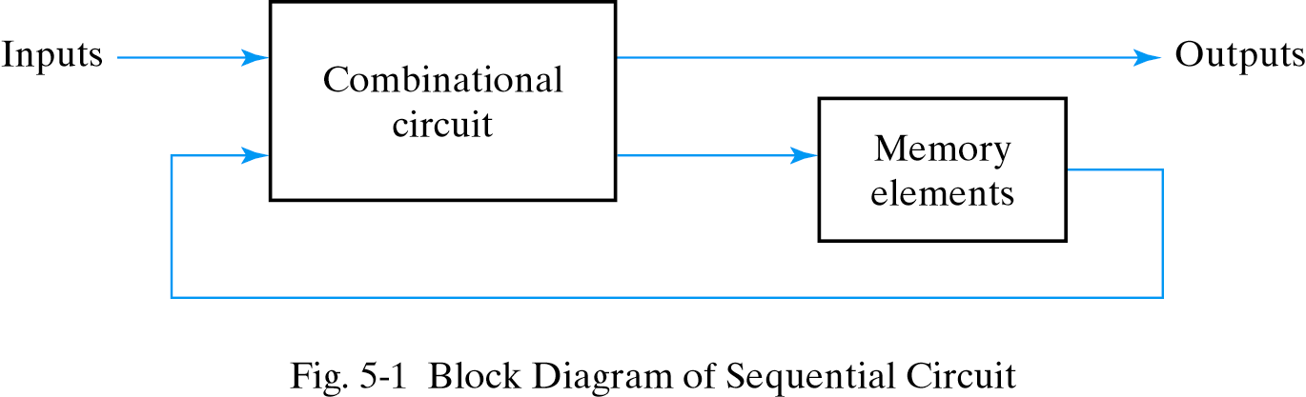
Sequential Circuits
There are two types of sequential circuits: Synchronous and Asynchronous

Slide 3
Types of Sequential Circuits
Two major types: depending on timing of their signals
Asynchronous sequential circuits (see Chapter 9)
The transition happens at any instant of time
Do not use clock pulses. Change of internal state occurs when there is a change in input variables
Instability problem: may become unstable at times
Storage elements work as time-delay device
May be regarded as a combinational circuit with feedback
Storage element’s propagation delay provides the required storage
Synchronous sequential circuits
The transition happens at discrete instants of time
The circuit responds only to pulses on particular inputs
Storage elements are affected only with the arrival of each pulse
The clock pulses determine when computational activity will occur within the circuit, and other signals determine what change will take place affecting the storage elements and the outputs

Slide 4
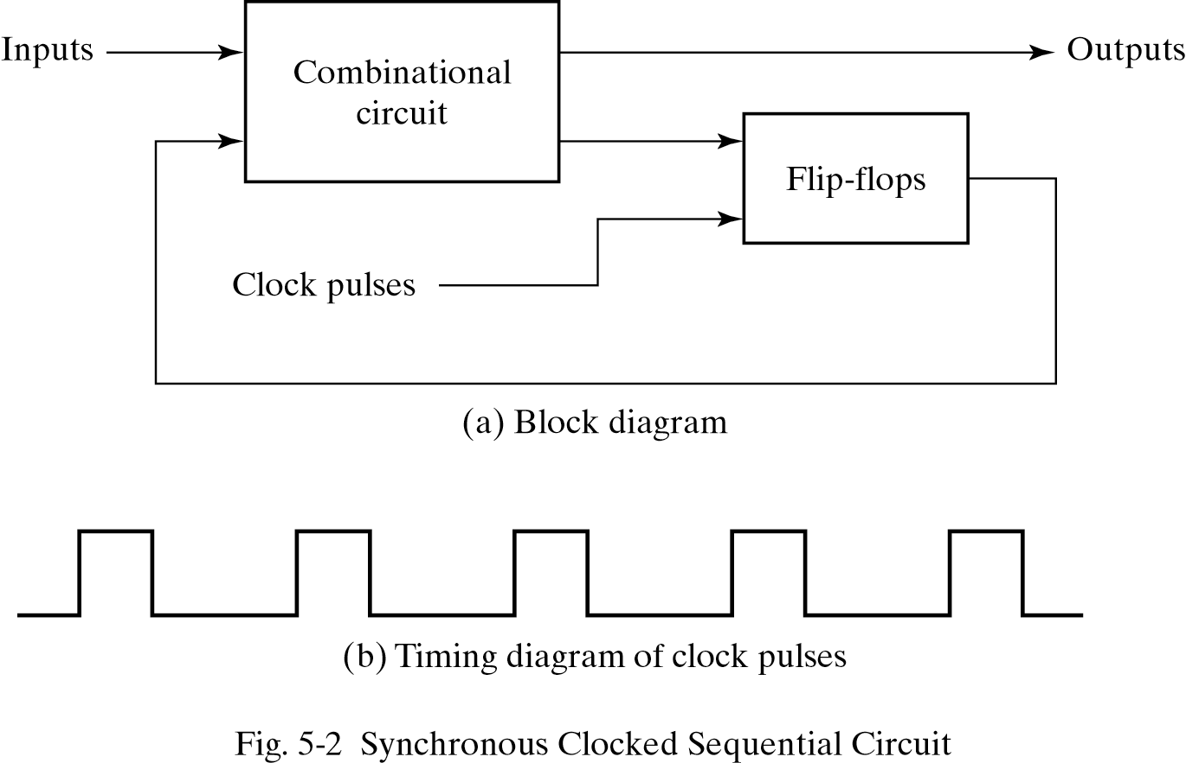
Synchronous Sequential Circuits
The outputs can come either from the combinational circuit or from the flip-flops or both The flip-flops receive their inputs from the combinational circuit and also from a clock signal with pulse that occurs at fixed intervals of time
The flip-flop outputs cannot change and the feedback loop is broken when a clock pulse is not active

Slide 5
Flip-Flops & Latches
latch
- level-sensitive device (operate with signal level)
- asynchronous sequential circuit
flip-flop
- edge-sensitive device (operate with signal transition)
- synchronous sequential circuit

Slide 6
Flip-Flops
Sequential Circuits use flip-flops as storage elements
Flip-Flop is a binary storage device that saves one bit of information
The outputs can come from flip-flops or combinational logic
Flip-flop inputs come from combinational logic or clock generators
used in clocked sequential circuit
prior to the occurrence of clock pulse, the combination logic forming the next value of the flip-flop must have reached a stable value so, propagation delay in combination circuit play an important role in determining the minimum interval between clock pulses that will allow the circuit to operate correctly.

Slide 7
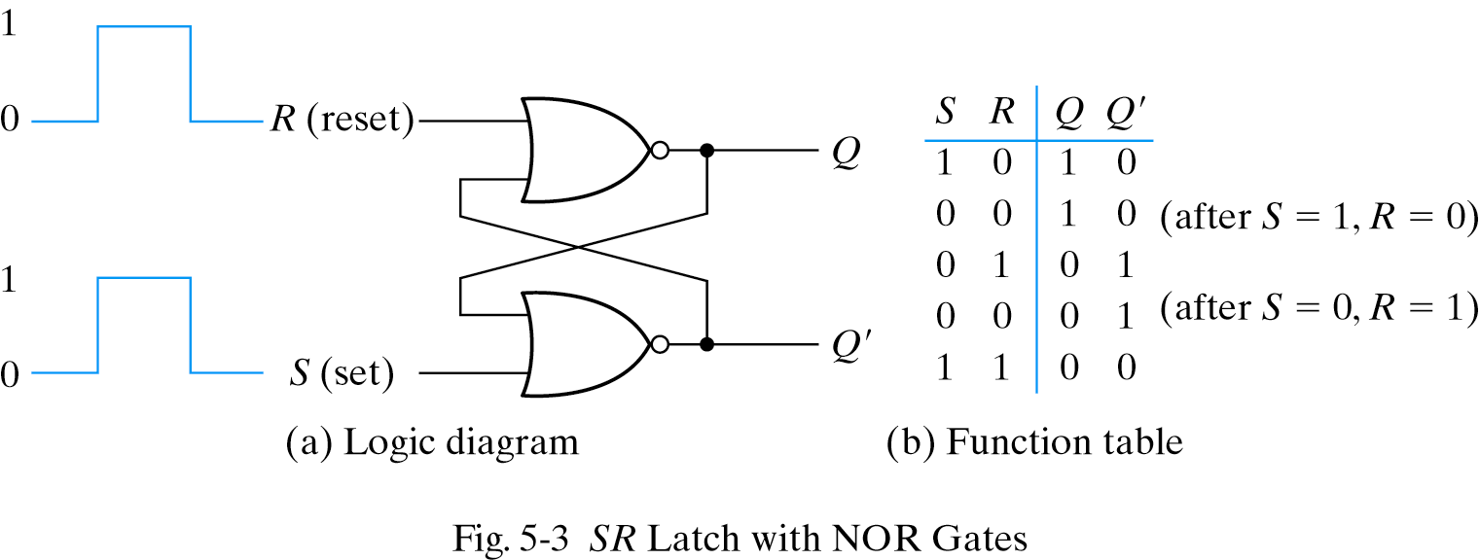
Latches
Different flip-flops are different based on the number of inputs
and how the inputs affect the binary state.
Basic types of flip-flops operate with signal levels and are called latches.
Example: SR latch
Two states: Set and Reset states
an asynchronous sequential circuit with two cross-coupled NOR gates
building blocks of flip-flops

Slide 8
SR Latches
1. two cross-coupled NOR gates
2. two cross-coupled NAND gates
SR latch is an important circuit because other useful latches and flip-flops are constructed from it
Two inputs labeled S for set and R for reset
(S,R)=(1,0): set (Q=1, the set state)
(S,R)=(0,1): reset (Q=0, the reset/clear state)
(S,R)=(0,0): normal condition
no operation, in either the set or the reset state
depending on which input was most recently at 1
(S,R)=(1,1): indeterminate state (Q=Q'=0)
consider (S,R) = (1,1) ⇒ (0,0) 으로 동시에 초기화시키고 set,reset 중 어느것이 먼저 0으로 되느냐에 따라 다음 state가 결정된다. (unpredictable) 만약, 동시에 0으로 되면, os에서 제어해줘야한다.
unpredictable next state when both inputs return to 0
(depend on which input returns to 0 first)

Slide 9
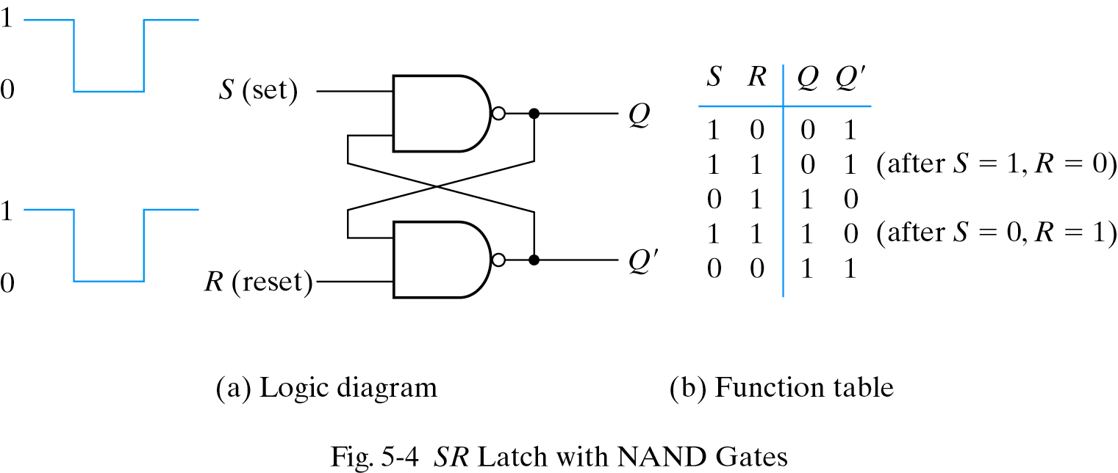
SR Latches with NAND Gates(S’-R’ Latch)
SR latch with two cross-coupled NAND gates
0 signal to change its state
(S,R)=(0,1): set (Q=1, the set state)
(S,R)=(1,0): reset (Q=0, the reset/clear state) (S,R)=(1,1): normal condition
(S,R)=(0,0): indeterminate state (Q=Q’=1)
unpredictable next state

Slide 10
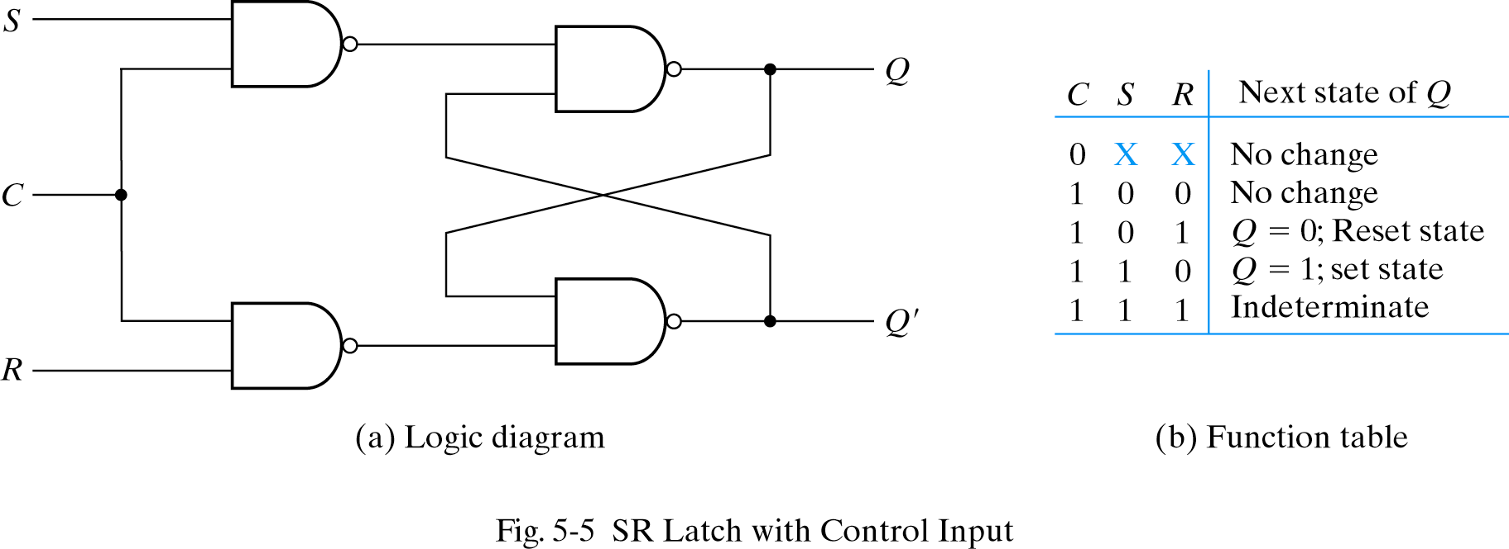
SR Latches with Control input
Determines when the state of the latch can be changed
C=0 ⇒ quiescent condition, no change
C=1 ⇒ S or R is allowed to affect the SR latch (1 signal to change its state)

Slide 11
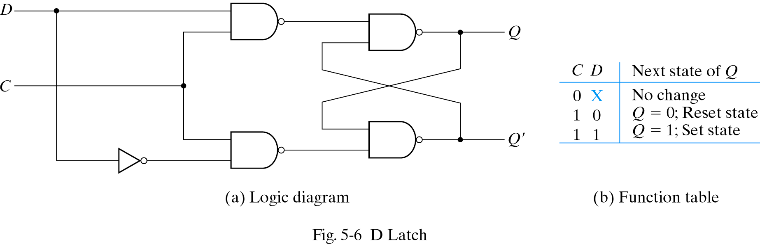
D Latch
S=D and R=D’
Ensure S and R are never equal to 1 at the same time
Eliminate the undesirable conditions of the indeterminate state in the SR latch
One output Q and two inputs: D (data) and C (control)
Q = D when C=1
Q = no change when C=0.
1
0
1
1
1
1
1
0
1
0
Also called a transparent latch

Slide 12
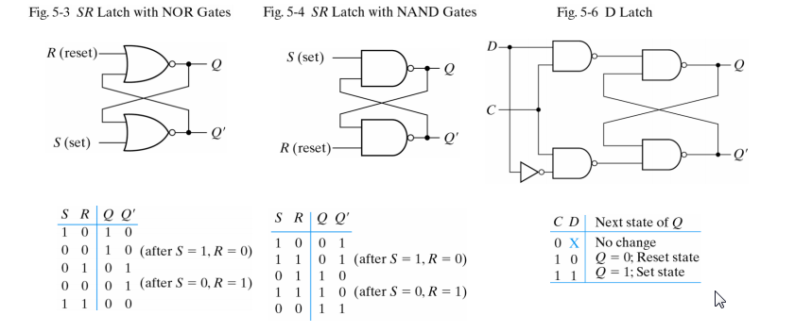
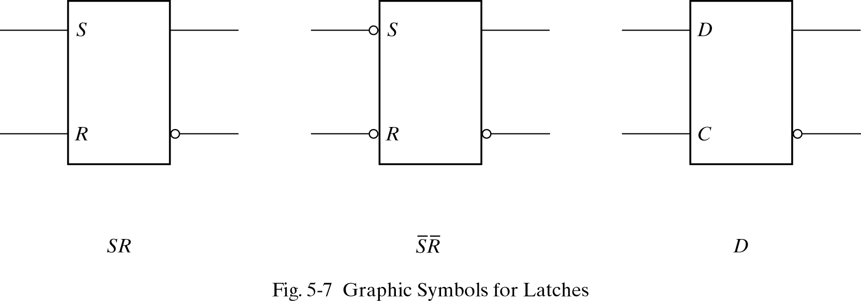
Diagrams, Function Tables, and Graphic Symbols for Latches
to indicate that setting and resetting occur with a logic 0 signal

Slide 13
Flip-Flips
A trigger: the momentary change to switch the state of a latch or flip-flop
The transition it causes is said to trigger the flip-flop
Types of triggers
Level triggered – latches
D latch is triggered every time the pulse(enable) stays at logic 1 level.
Be used as a temporary storage between a unit and its environment
Edge triggered – flip-flops
If level-triggered flip-flops are used, the feedback path may cause instability problem as long as the clock pulse stays in the active level
triggered only during a signal transition (0⇒1 or 1⇒0)

Slide 14
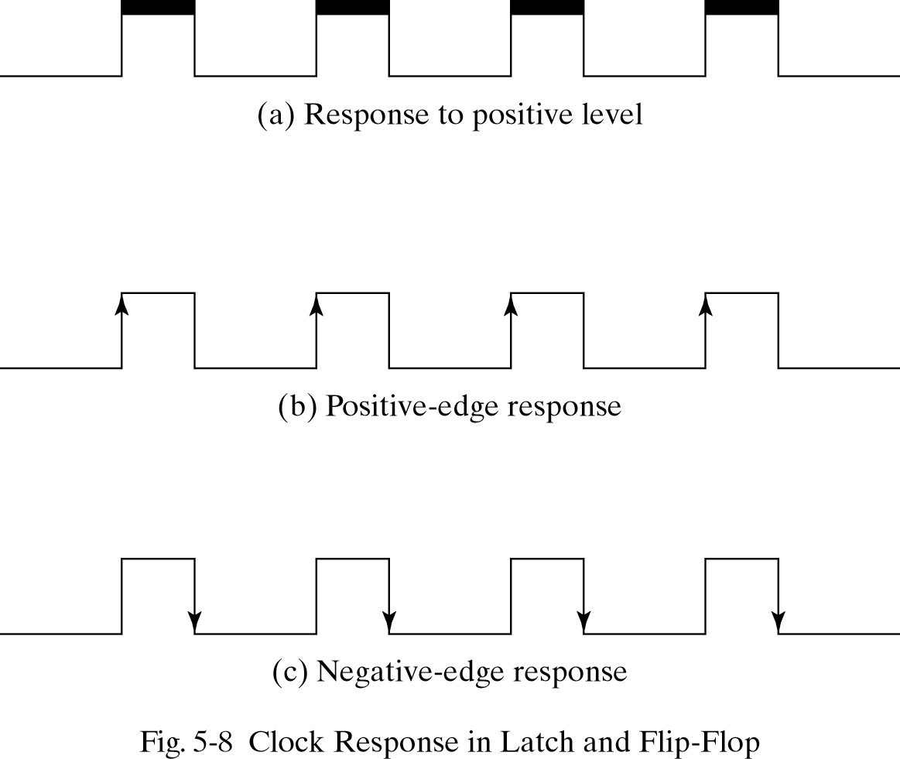
Flip-Flips
Many flip-flops are edge triggered:
They respond to the input only during transition from 0 to 1 or from 1 to 0.

Slide 15
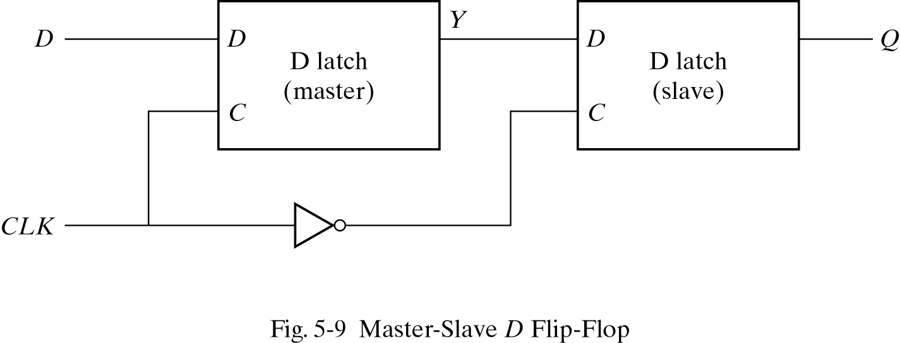
Edge-Triggered D Flip-Flop
Store binary info during transition
Master-slave D flip-flop
two separate latch
a master latch (positive-level triggered)
a slave latch (negative-level triggered)
change only during negative edge of clock (1->0)
longer propagation delay
Data blocked here while CLK =1
1
1
1
0

Slide 16
Edge-Triggered D Flip-Flop
The output can change only when clock goes from 1 to 0.
Data passes here while CLK =0
1
1
1
0
1

Slide 17
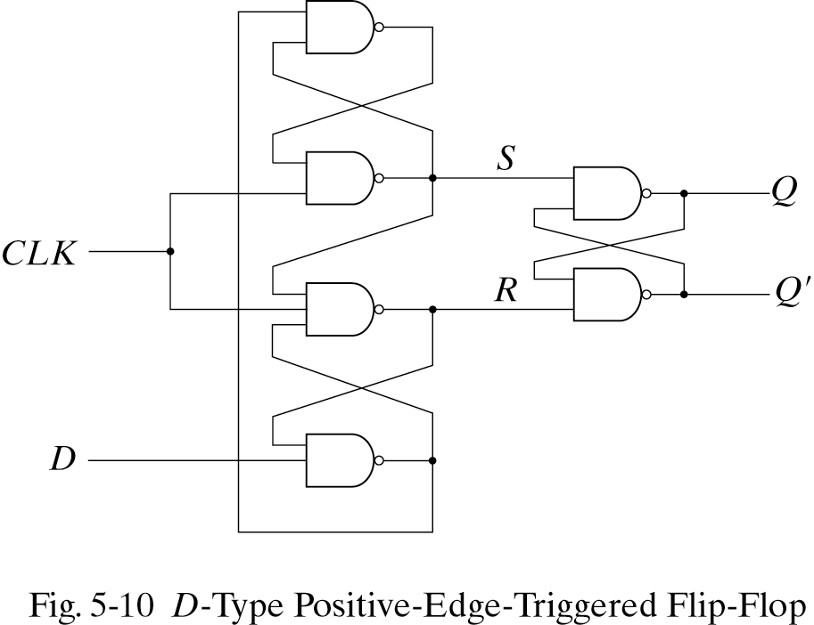
Positive Edge-Triggered D Flip-Flop
How is this a positive edge triggered? Lets look at all possible scenarios:
a) CLK = 0, then S=R=1 which causes the output to stay unchanged.
1
0
1

Slide 18
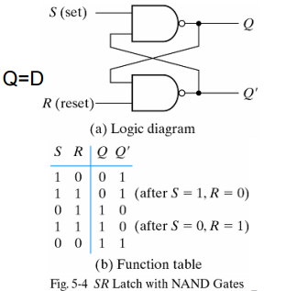
Positive Edge-Triggered D Flip-Flop
How is this a positive edge triggered? Lets look at all possible scenarios:
a) CLK = 0, then S=R=1 which causes the output to stay unchanged.
1
Q=R ⇒
0
1

Slide 19
Positive Edge-Triggered D Flip-Flop
What if CLK goes from 0 to 1? (↑ : Positive-edge) Q=D (state changes once)
a) D = 0, when CLK becomes 1, R changes 1 to 0. Flip-Flop goes to reset state. Q=0.
If D changes while CLK = 1, R remains 1. Q does not change.
1
S used to be 1 when CLK was 0
1
1
1
0
1
1
0
Since one input is 0 changes in D can’t change Q
0
1

Slide 20
Positive Edge-Triggered D Flip-Flop
What if CLK goes from 0 to 1? (Positive-edge)
b) D = 1, when CLK becomes 1, S changes to 0. Flip-Flop goes to set state. Q=1.
If D changes while CLK = 1, R remains 0. Q does not change.
0
1
S and R used to be 1 when CLK was 0
1
1
0
1
1
1
0
1
1
0
Since one input is 0 changes in D can’t change Q
1
1
0

Slide 21
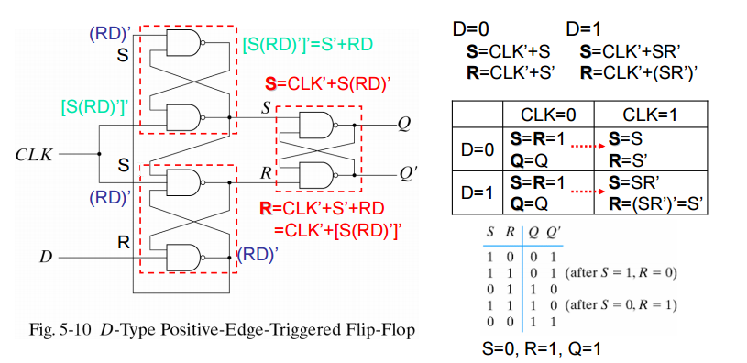
Positive Edge-Triggered D Flip-Flop

Slide 22
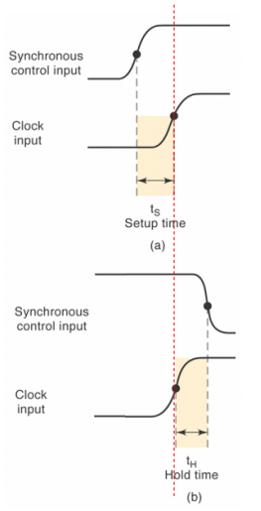
Setup Time and Hold Time
Setup time
a minimum time for which the D input must be maintained at a constant value (or be ready) prior to the occurrence of the clock transition
data to the internal latch
switching이 일어나기 전까지 입력이 정확히 인식되는 데 필요한 최소 유지 시간을 말한다.
Hold time
a minimum time for which the D input must not changes after the application of the positive transition of the clock
clock to the internal latch
switching이 일어난 후 상태가 정확히 인식되도록 필요한 최소 시간을 말한다.

Slide 23
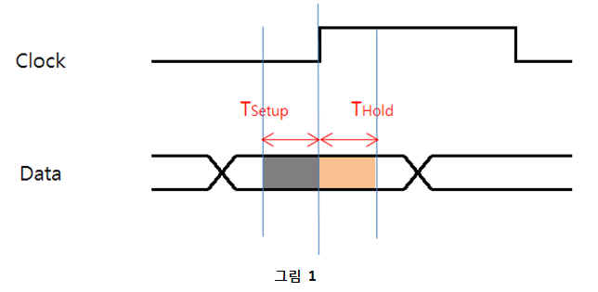
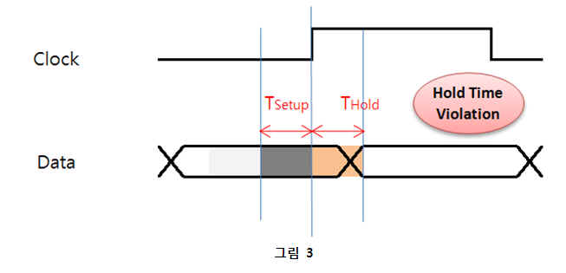
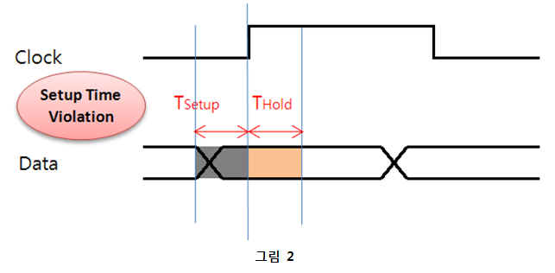
Setup Time and Hold Time
§ setup Time이란?
Switching이 일어나기 전까지 입력이 정확히 인식되는데 필요한 최소 유지 시간을 말합니다. 즉 Data의 파형이 High인지 Low인지를 판별하는데 필요한 최소시간을 의미합니다.
§ Hold Time이란?
Switching이 일어난 후 상태의 변화가 정확히 인식되도록 필요한 최소 시간을 말합니다. 즉 판별된 결과가 유지되어야 하는 최소시간을 의미합니다.
아래의 그림 1은 Setup Time과 Hold time을 만족시키는 그림입니다.
아래의 그림 2는 Setup Time Violation에 대한 그림입니다. 그림 3은 Hold Time Violation에 대한 그림입니다.

Slide 24
Setup Time and Hold Time
§ Setup Time과 Hold Time을 만족시키지 않을 때의 문제점
그렇다면 이번에는 Setup Time과 Hold Time을 만족시키지 않았을 때는 어떠한 문제점이 생기는지에 대해 알아보겠습니다.
우선 당연한 말이지만 정상 동작을 하지 못하게 됩니다.
쉽게 설명하자면 위의 그림 2를 보면 Clock이 “1”이 되었을 때 Data의 경우 Chip이 요구하는 Setup Time까지 “1”을 유지하고 있어야
“1”로 인식하게 됩니다. 하지만 요구하는 Setup Time 전에 Data가 Switching 되고 있다는 것을 볼 수 있습니다. 따라서 이러한 경우
Data가 “0”인지 “1”인지를 정확하게 인식하지 못해 오작동을 할 수 있다는 겁니다. 이를 Setup Time Violation이라고 합니다.
마찬가지로 Hold Time Violation은 그림 3에서 보듯이 Clock이 “1”이 된 후에 Data는 Chip이 요구하는 Hold Time을 유지하고 있어야
정확하게 “1”이라고 판별하게 됩니다. 하지만 그 전에 다시 Switching이 되므로 역시 “1”인지를 정확하게 인식하지 못하게 됩니다.

Slide 25

Setup Time and Hold Time
§ Timing은 “길이”가 아닌 “Delay”
그렇다면 이러한 Setup/Hold Time Violation이 발생되지 않게 하기 위해선 어떻게 해야 할까요?
위의 그림에서 보듯이 결국은 Clock의 Delay와 Data의 Delay를 고려해서 Setup Time과 Hold Time의 Margin안에 들어오게 설계를 하면 됩니다.
여기서 중요한 점은 “길이”를 맞추는 것이 아니고 “Delay”를 맞춰야 한다는 겁니다.
왜냐하면 같은 길이라고 할지라도 Microstrip과 Stripline의 Delay는 차이가 나기 때문입니다.
아래의 그림 및 표는 길이 등 다른 조건은 모두 동일하고 구조만 Microstrip과 Stripline으로 구현한 Simulation 결과입니다.
위의 결과를 보면 알 수 있듯이 파형이나 특성 등에는 큰 차이가 없으나 Flight Time 즉, Delay는 차이가 난다는 것을 알 수 있습니다.
다음의 수식을 보면 일반적으로 Microstrip 구조에서 속도가 더 빠르다는 것을 알 수 있습니다.
여기서 v는 propagation velocity이며, c는 빛의 속도, er은 유전율, TD는 time delay, 그리고 x는Transmission Line의 길이를 의미합니다.
예를 들어 같은 Bus의 Signal 중 어떤 net은 Stripline에 배선을 하고 어떤 net은 Microstrip에 배선을 한 경우 길이를 동일하게 설계했더라도 System이 정상적인 동작을 하지 않을 수도 있다는 말입니다.
이렇듯 Timing은 길이를 맞춘다고 되는 것이 아니고 Delay를 맞춰야 되는 문제이므로 System의속도가 점점 더 빨라짐에 따라 Timing을 맞추기 위해서는 더 많은 신경을 써야만 합니다.

Slide 26
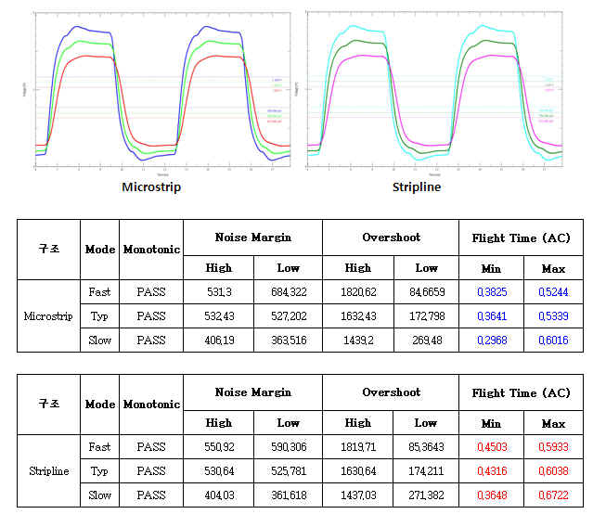
Setup Time and Hold Time

Slide 27
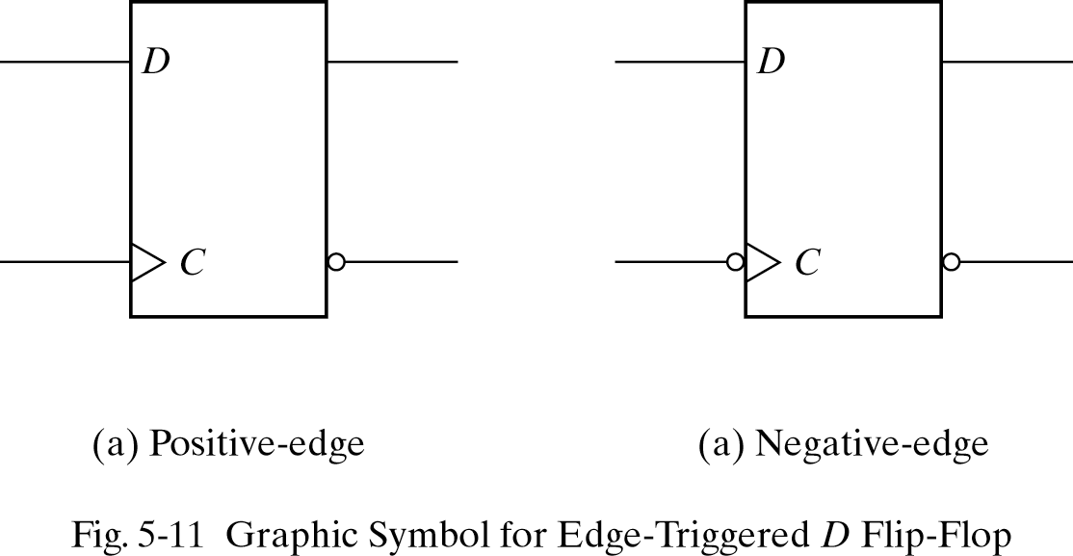
Graphic Symbols
dynamic indicator – response to the edge transition

Slide 28
Other Flip-Flops
Each flip-flop is made of interconnection of gates.
The edge-triggered D flip-flop is the most efficient flip-flop since it requires the least number of gates.
Other flip-flops are made using the D flip-flop and extra logic.
Two flip-flops widely used are the JK and T flip-flop.

Slide 29
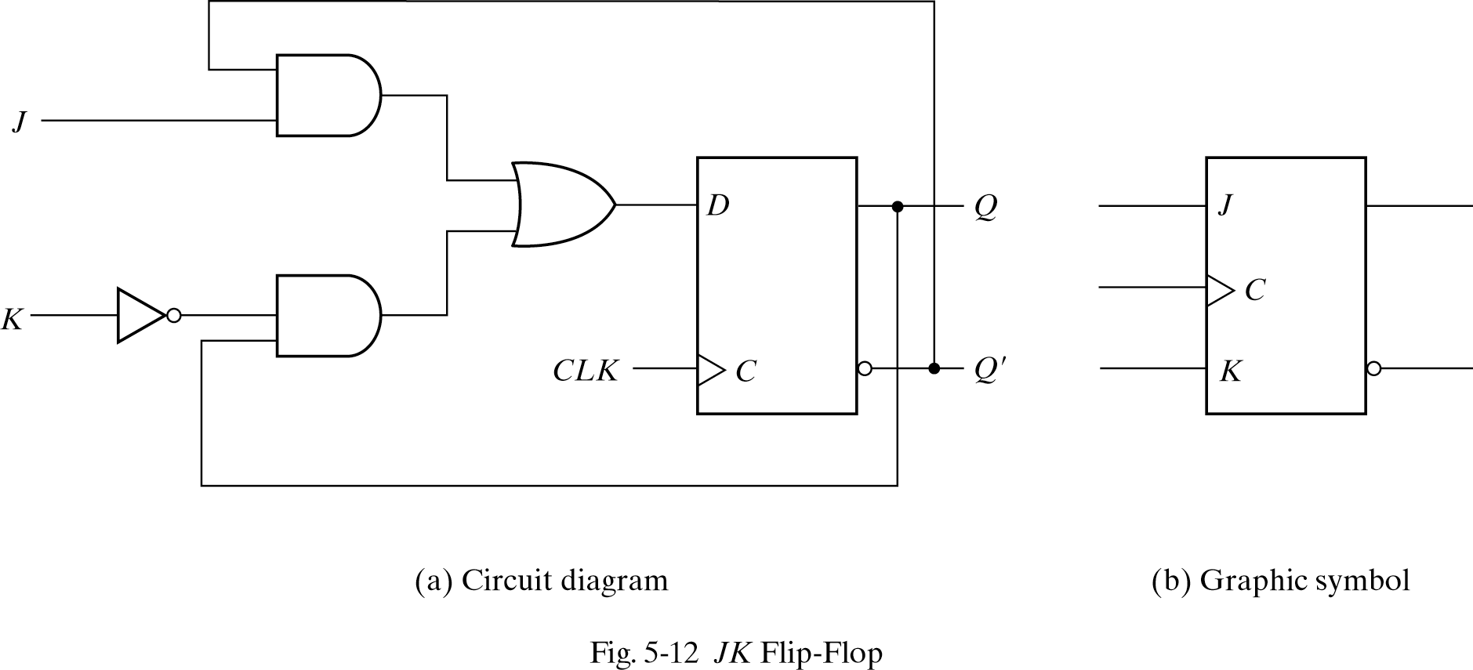
JK Flip-Flop
Three flip-flop operations: Set, Reset, Complement output.
JK performs all three

Slide 30
JK Flip-Flop
JK Flip-Flop: D=JQ'+K'Q
J=0, K=0: D=Q ⇒ Q no change
J=0, K=1: D=0 ⇒ Q =0 reset to 0
J=1, K=0: D=1 ⇒ Q =1 set to 1
J=1, K=1: D=Q’ ⇒ Q =Q’ complement output

Slide 31
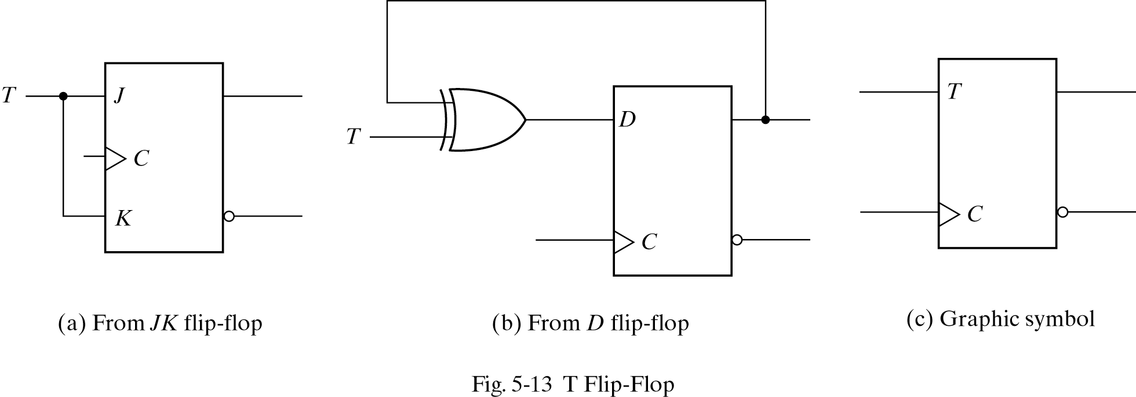
T Flip-Flop
T (Toggle) flip-flop is a complementing one.
T flip-flop is obtained from a JK when inputs J and K are tied together.
useful for designing binary counters

Slide 32
T Flip-Flop
If T=0 ( J=K=0) D=Q, output does not change.
If T=1 ( J=K=1) D=Q’ output is complemented.
A T flip-flop can also be made of D flip-flop and a XOR.
D = T ⊕ Q = TQ’ + T’Q

Slide 33
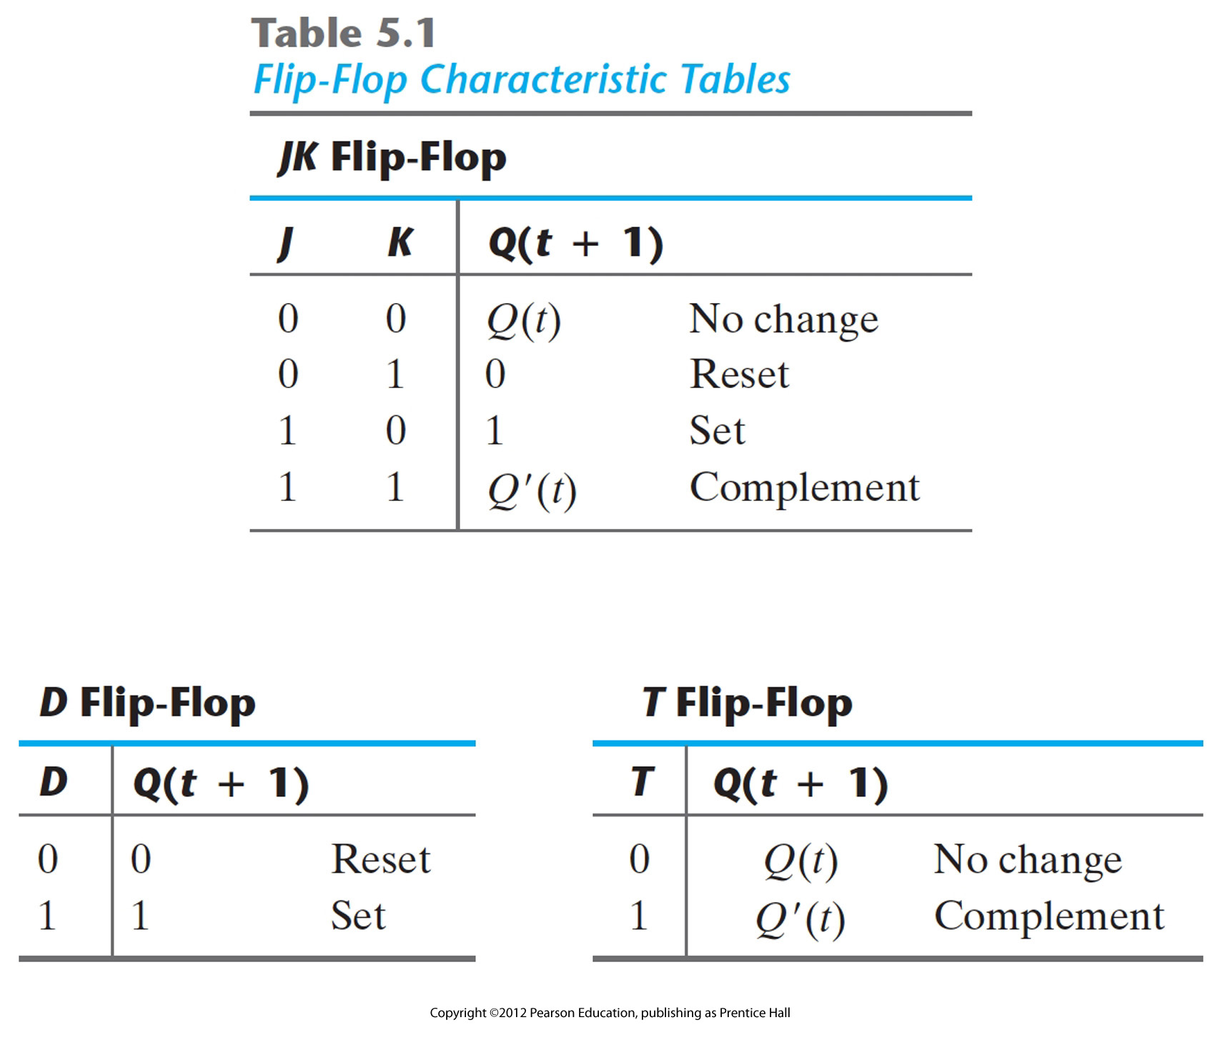
Characteristic Tables - defines the logical properties of a flip-flop by describing its operation in tabular form
Characteristic equations
D flip-flop Q(t+1) = D
JK flip-flop Q(t+1) = JQ’+K’Q
T flop-flop Q(t+1) = T ⊕Q = TQ’ + T’Q

Slide 34
Direct Inputs
Some flip-flops have asynchronous inputs to force the flip-flop to a particular state.
Examples: Direct Set, Direct Reset.
The input that sets the flip-flop to 1 is called preset or direct set.
The input that clears the flip-flop to 0 is called clear or direct reset.
Works independent of clock.
when power is turned on in a digital system, the state of the flip-flops is unknown. the direct inputs are useful for bringing all flip-flops in the system to a known starting state prior to the clocked operation.

Slide 35
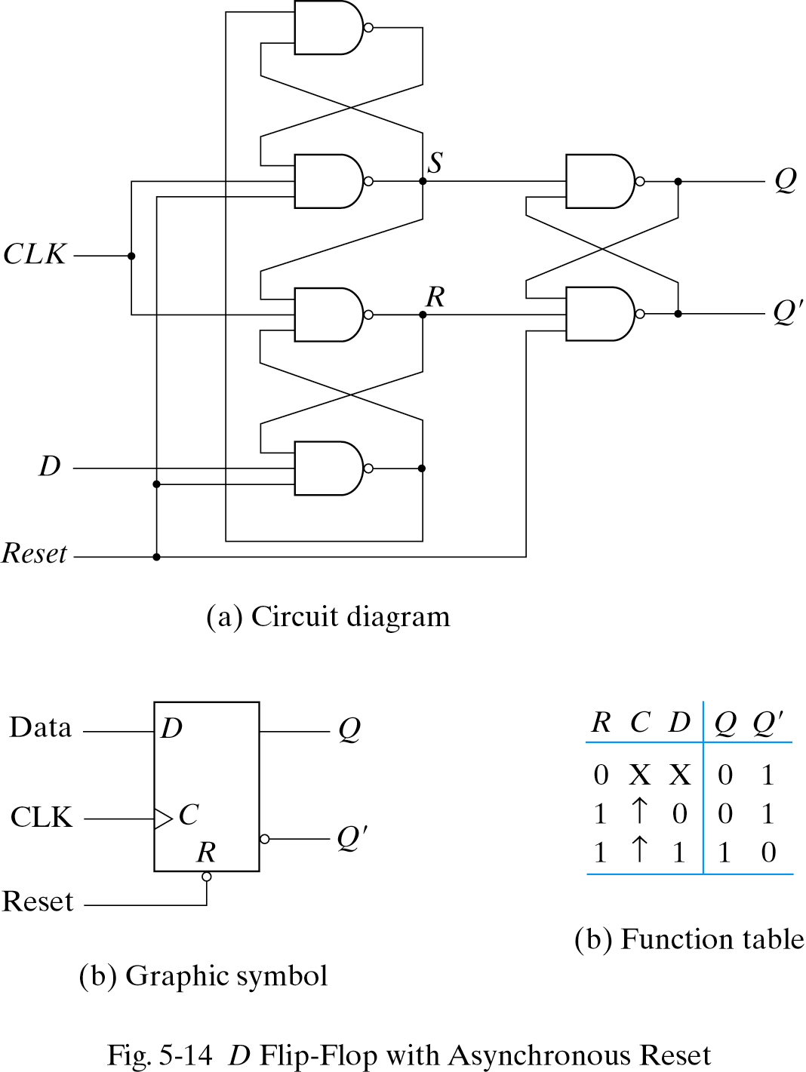
Direct Inputs: Asynchronous Reset
Note reset signal for D flip flop
If R = 0, the output Q is cleared
This event can occur at any time, regardless of the value of the CLK
positive edge
bubble indicates that the reset is active at the logic 0 level

Slide 36
Analysis of Clocked Sequential Circuits
Analysis: Obtaining a table/diagram for the time sequence of inputs/outputs/internal states.
Examples: State Equations, State Table, State Diagram
circuit diagram → equations → state table → state diagram
state equation : an algebraic expression that specifies the condition (transition equation) for a flip-flop state transition
output equation : the part of the combinational circuit that generates external outputs is described algebraically by a set of Boolean function.
flip-flop input equation : the part of the combinational circuit that generates the inputs to the flip-flops is described algebraically by a set of Boolean functions.
ex) J_{A}=B
1) gate-level description
the designer understands how to select and connect gates and flip-flops to form a circuit having a particular behavior. that understanding comes with experience
2) behavioral modeling
does not require the designer to know how to invent a schematic, extensive background in electrical engineering, experience.
needs only to know to describe behavior using the constructs of HDL, because the circuit is produced automatically by a synthesis tool

Slide 37
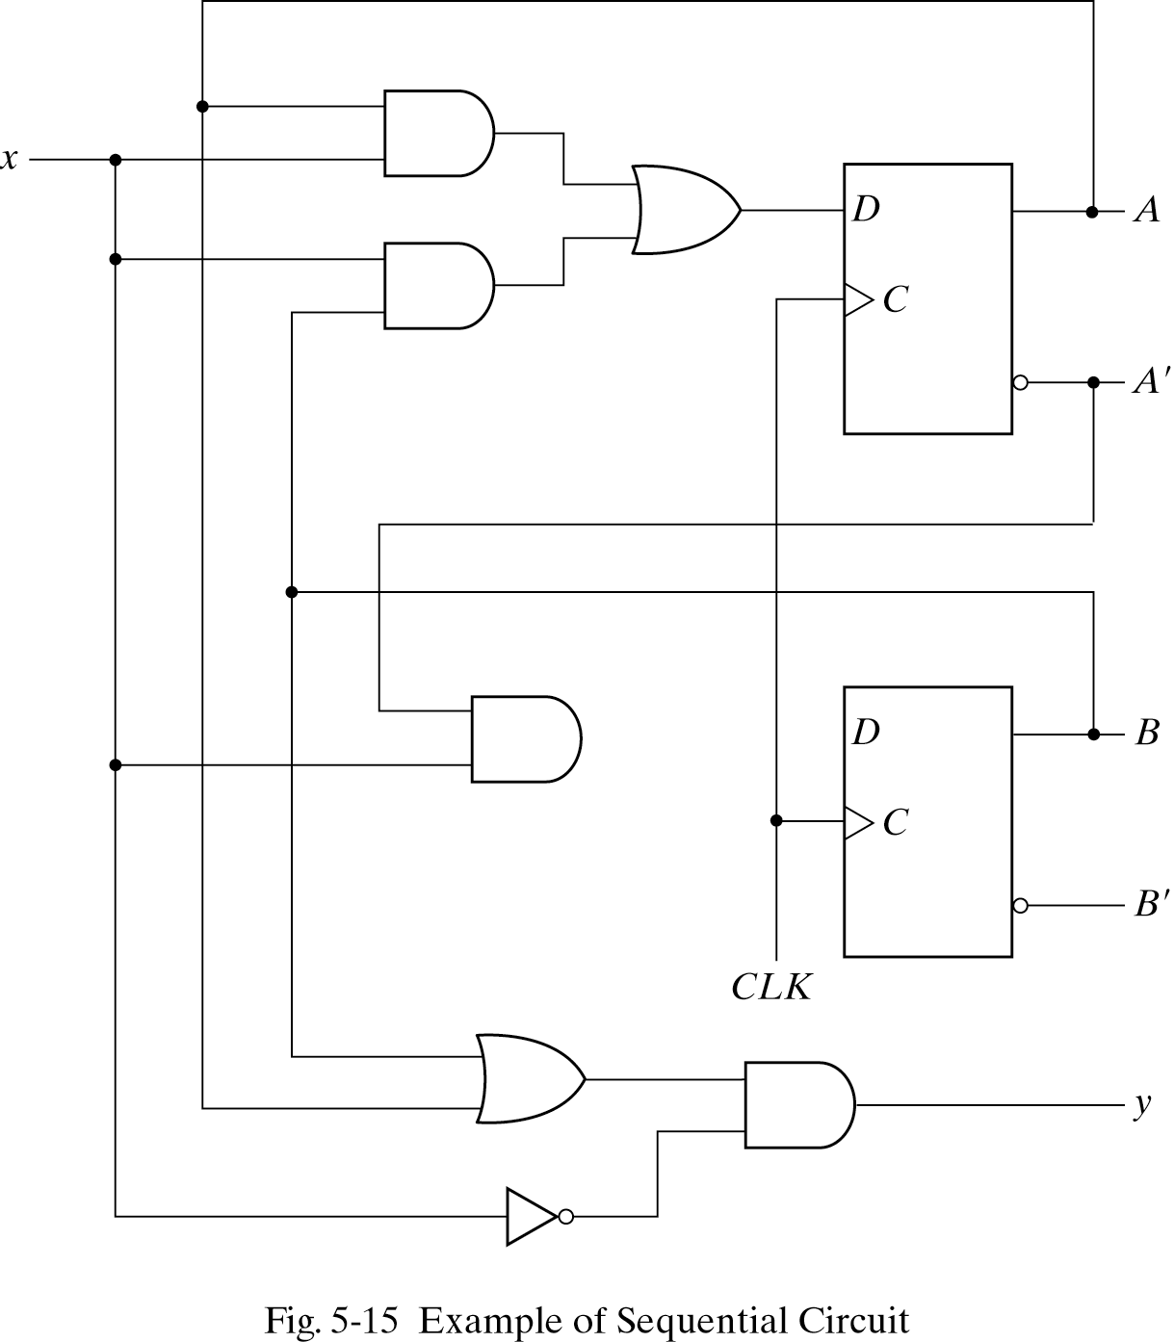
Analysis of Clocked Sequential Circuits
Example of state equation:
A(t+1) = A(t)x(t) + B(t)x(t)
B(t+1) = A’(t)x(t)
A(t+1)=Ax+Bx
B(t+1)=A’x
y(t)=(A(t)+B(t)).x’(t)
= (A+B)x’

Slide 38
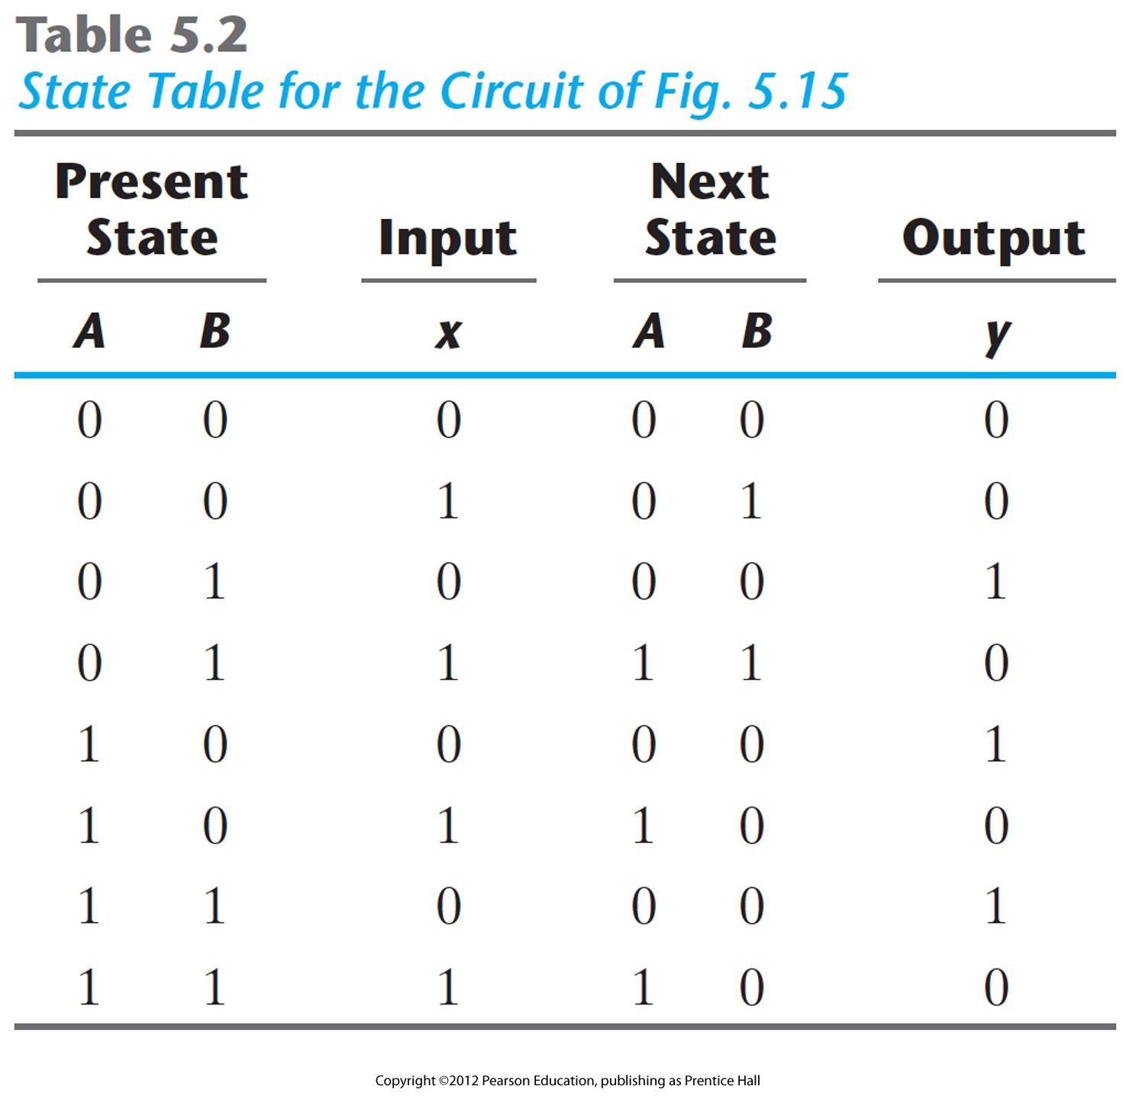
Example of state tables
Sequence of outputs, inputs, and flip flop states enumerated in state table
Present state indicates current value of flip flops
Next state indicates state after next rising clock edge
Output is output value on current clock edge (present state & input value function)
State equation:
A(t+1) = A(t)x(t) + B(t)x(t)
B(t+1) = A’(t)x(t) y(t)=(A(t)+B(t)).x’(t)

Slide 39
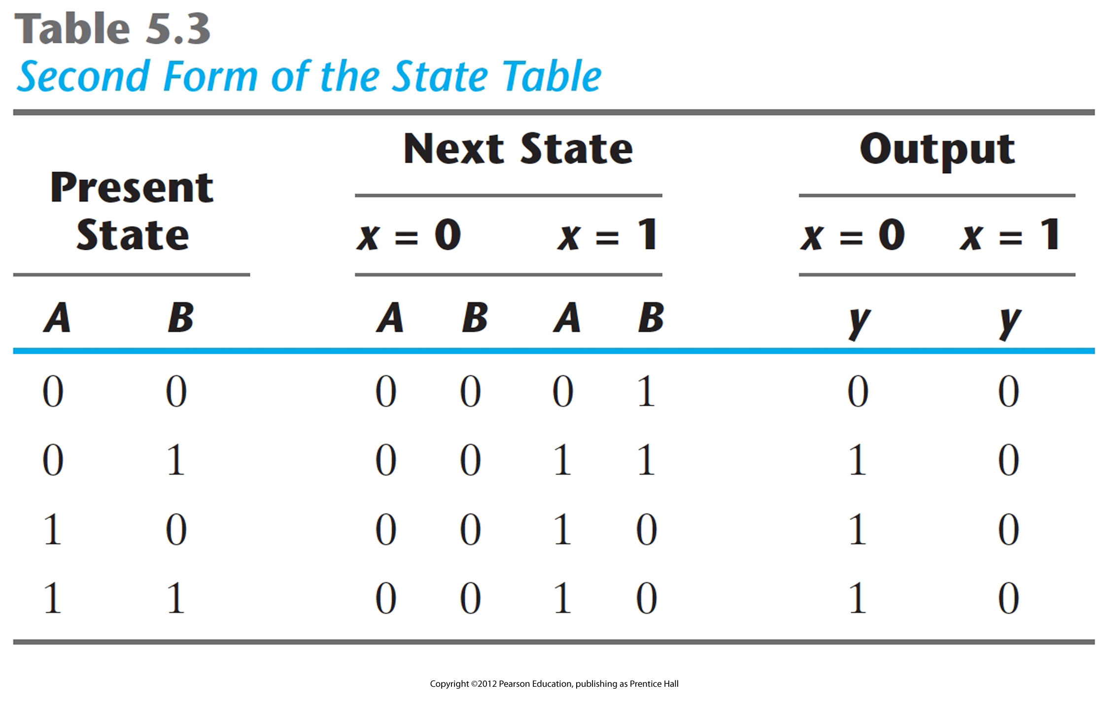
Example of state tables-2nd form
All possible input combinations enumerated
All possible state combinations enumerated
Separate columns for each output value.
Sometimes easier to designate a symbol for each state.

Slide 40
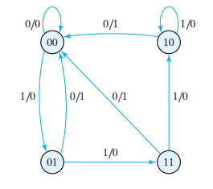
Example of state diagram
: graphically representation for state table , gives a pictorial view of state transitions and is the form more suitable for human interpretation of the circuit’s operation
Present state Next State Output
x=0 x=1 x=0 x=1
AB AB AB y y
00 00 01 0 0
01 00 11 1 0
10 00 10 1 0
11 00 10 1 0
Circles indicate current state
Arrows point to next state
For x/y, x is input and y is output
FIGURE 5.16 State diagram of the circuit of Fig. 5.15

Slide 41
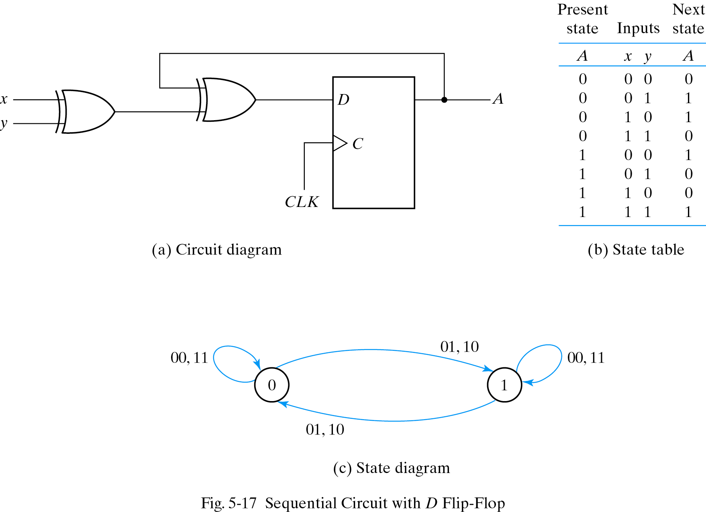
Analysis- D flip-flop
Note: this example
has no output

Slide 42
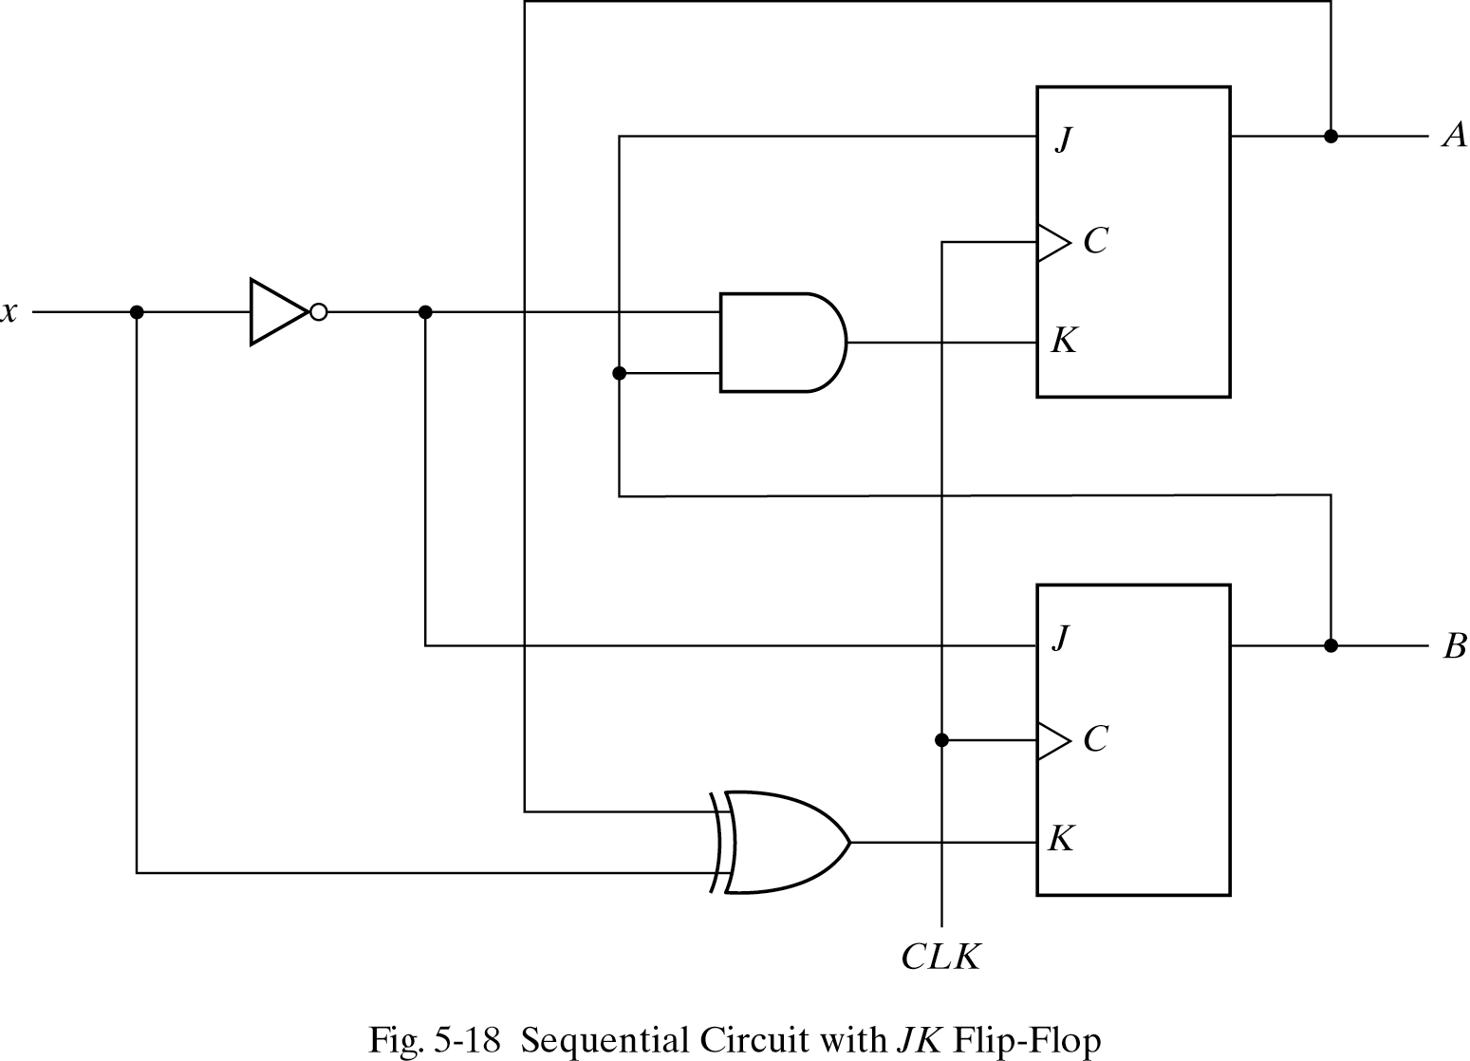
Analysis: JK flip-flop
J_{A}=B
K_{A}=Bx’
J _{B}=x’
K_{B}=A’x+Ax’

Slide 43
Analysis: JK flip-flop
A(t+1)=JA’+K’A
B(t+1)=JB’+K’B
A(t+1)=BA’+(Bx’)’A=A’B+AB’+Ax
B(t+1)=x’B’+(A XOR x’)B
=B’x’+ABx+A’Bx’
no output!
(may be output = flip-flop’s
output)
moore machine

Slide 44
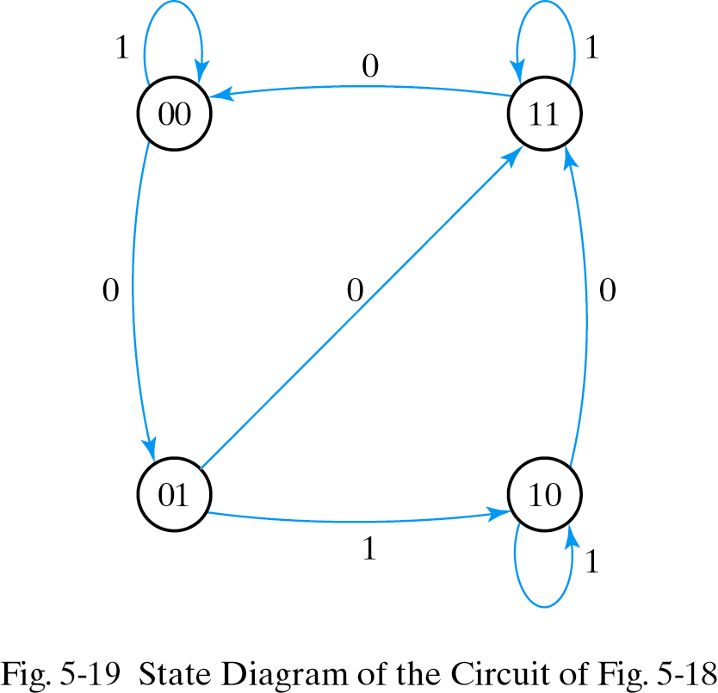
Analysis: JK flip-flop
Present state input Next State
A B x A B
0 0 0 0 1
0 0 1 0 0
0 1 0 1 1
0 1 1 1 0
1 0 0 1 1
1 0 1 1 0
1 1 0 0 0
1 1 1 1 1

Slide 45
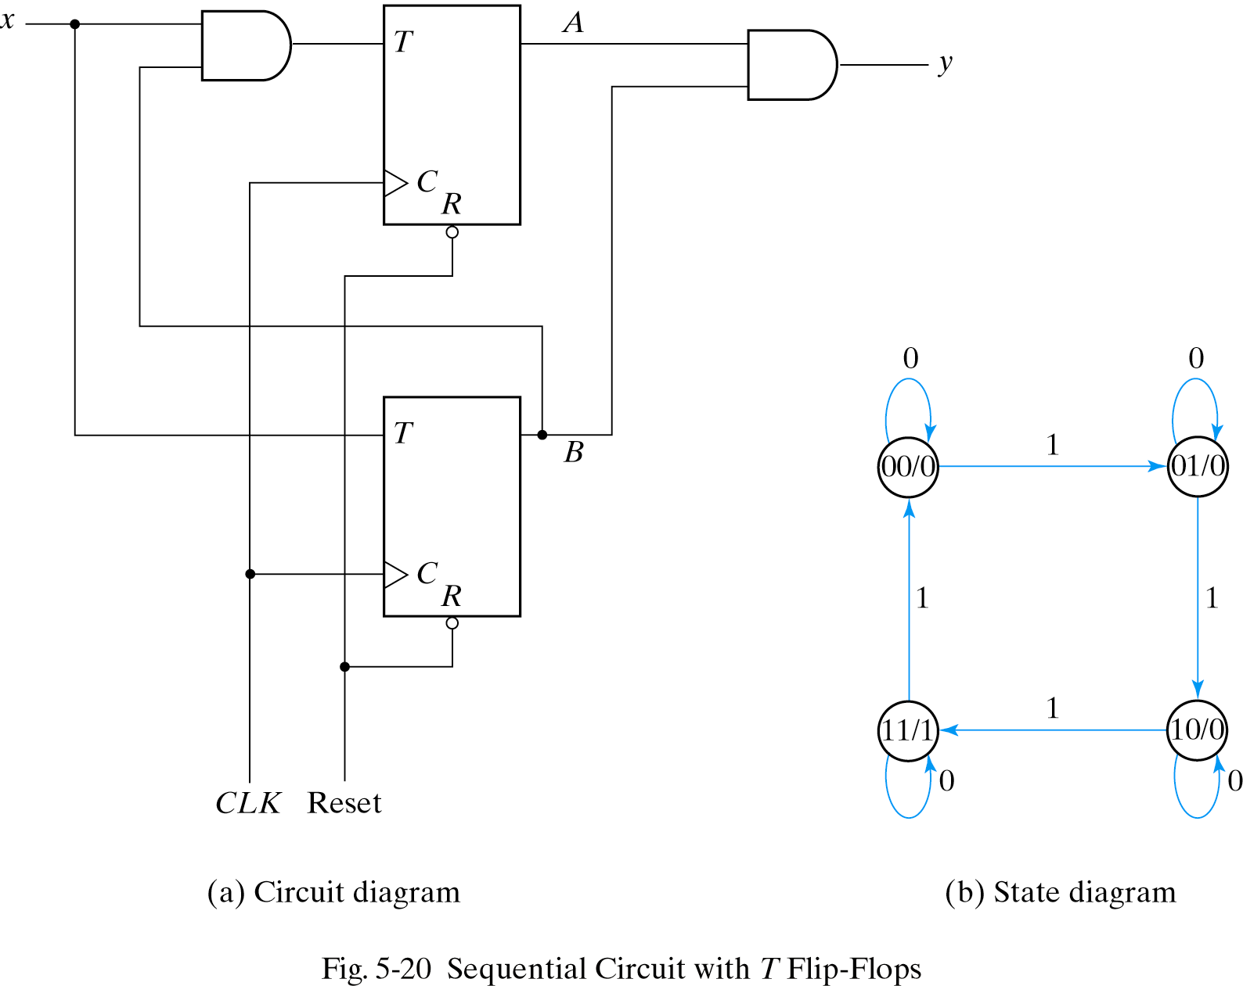
Analysis: T flip-flop
Q(t+1)=T’Q+TQ’
T_{A}=Bx
T_{B}=x
y=AB
A(t+1)=(Bx)’A+(Bx)A’
=AB’+Ax’+A’Bx
B(t+1)=x XOR B

Slide 46
next-state value computation using characteristic table
determine the flip-flops input equations in terms of the present state and input variables
list the binary values of each input equation
use the corresponding flip-flop characteristic table to determine the next-state values in the state table
ex) J_{A}=B K_{A}=Bx’ J _{B}=x’ K_{B}=A’x+Ax’
<state table> flip-flop inputs + characteristic table
Present state input Next State flip-flop inputs
A B x A B J_{A} K_{A} J _{B} K_{B}
0 0 0 0 1 0 0 1 0
0 0 1 0 0 0 0 0 1
0 1 0 1 1 1 1 1 0
0 1 1 1 0 1 0 0 1
1 0 0 1 1 0 0 1 1
1 0 1 1 0 0 0 0 0
1 1 0 0 0 1 1 1 1
1 1 1 1 1 1 0 0 0

Slide 47
next-state value computation using characteristic equation
determine the flip-flops input equations in terms of the present state and input variables
substitute the flip-flop input equations in to the flip-flop characteristic equation to obtain the state equation
use the corresponding state equation to determine the next-state values in the state table
ex)
1. flip-flop input equation
J_{A}=B K_{A}=Bx’ J _{B}=x’ K_{B}=A’x+Ax’
2. characteristic equation
A(t+1) = JA` + K`A B(t+1) = JB` + K`B
3. state equation :
A(t+1) = BA` + (Bx`)`A = A`B + AB` + Ax
B(t+1) = x`B` + (A^B)`B = x`B` + (Ax + A`x`)B = B`x` + ABx + A`Bx`
In state table “flip-flop input” are not needed when state equations are used

Slide 48
Mealy Machine
Output based on state and present input
Asynchronous signals
in order to synchronize, the inputs of the sequential circuit must be synchronized with the clock and the outputs must be sampled immediately before the clock edge
the outputs may change if the inputs change during the clock cycle
moreover, the outputs may have momentary false value because of the delay encountered from the time that the inputs change and the time that the flip-flop outputs change.
Comb.
Logic
Q(t+1)
Comb.
Logic
Flip
Flops
next
state
Q(t)
Y(t)
X(t)
present
state
present
input
clk

Slide 49
Moore Machine
Output based on state only
Outputs change synchronously with state changes
the outputs of the sequential circuit are synchronized with the clock, because they depend only on the flip-flop outputs that are synchronized with the clock
Comb.
Logic
Comb.
Logic
Q(t+1)
Y(t)
Flip
Flops
next
state
Q(t)
X(t)
present
state
present
input
clk

Slide 50
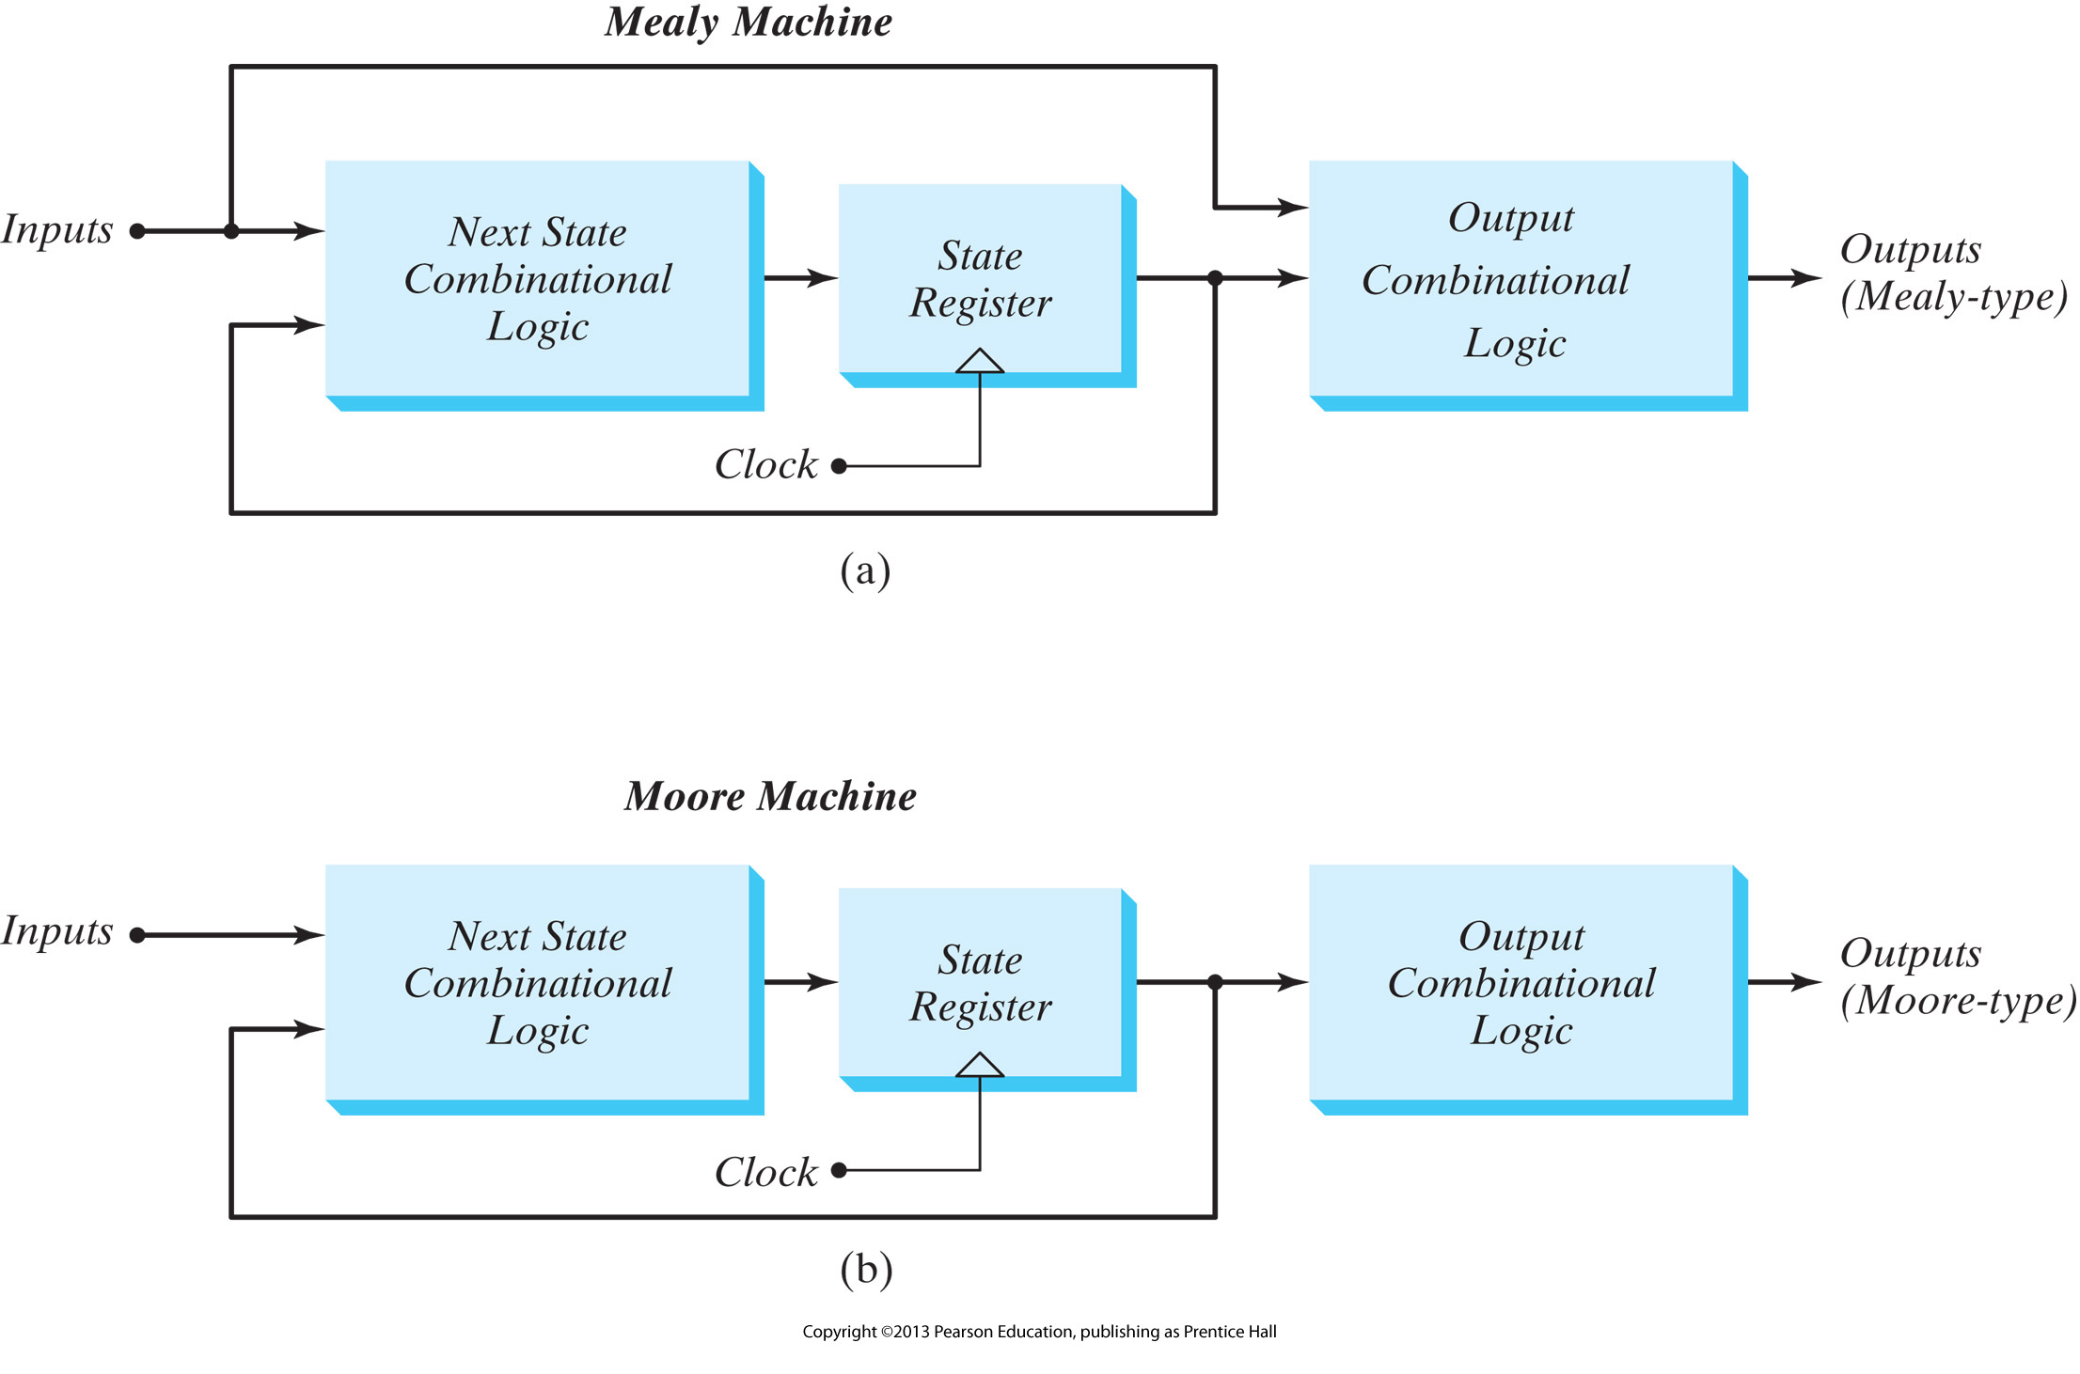
Mealy versus Moore

Slide 51
State Diagram with One Input & One Mealy Output
Mano text focuses on Mealy machines
State transitions are shown as a function of inputs and current outputs.
e.g. 1
0/0
Input(s)/Output(s) shown in transition
1/1
S1
1/0
S4
0/0
S2
0/0
0/0
1/0
S3
1/0

Slide 52
State Diagram with One Input & a Moore Output
Moore machine: outputs only depend on the current state
Outputs cannot change during a clock pulse if the input variables change
Moore Machines usually have more states.
No direct path from inputs to outputs
Can be more reliable

Slide 53
Designing Finite State Machines
Six Step Process
1. Understand the statement of the Specification
2. Obtain an abstract specification of the FSM
(state table or state diagram)
3. Perform a state minimization
4. Perform state assignment
5. Choose FF types to implement FSM state register
and build excitation table
6. Combinational circuit minimization

Slide 54
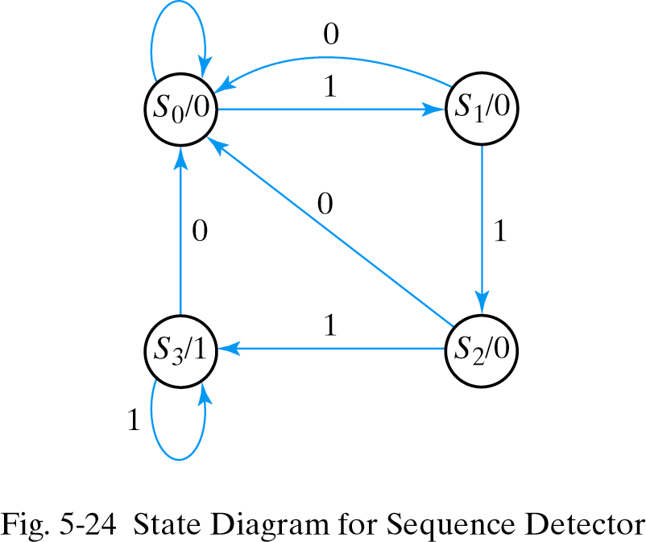
Example: Detect 3 Consecutive 1 inputs
0
State S₀ : zero 1s detected
State S₁ : one 1 detected
State S₂ : two 1s detected
State S₃ : three 1s detected
Note that each state has 2 output arrows
Two bits needed to encode state

Slide 55
State Table for Sequence Detector
Present
State
Next
State
Sequence of outputs, inputs, and flip flop states enumerated in state table
Present state indicates current value of flip flops
Next state indicates state after next rising clock edge
Output is output value on current clock edge
Input
Output
A B x A B y
0 0 0 0 0 0
0 0 1 0 1 0
0 1 0 0 0 0
0 1 1 1 0 0
1 0 0 0 0 0
1 0 1 1 1 0
1 1 0 0 0 1
1 1 1 1 1 1
S₀ = 00
S₁ = 01
S₂ = 10
S₃ = 11

Slide 56
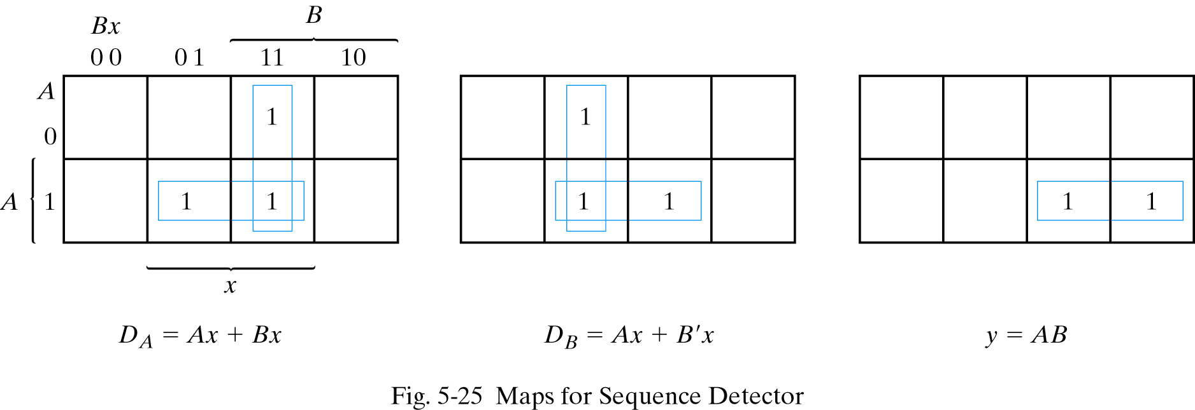
Finding Expressions for Next State and Output Value
Create K-map directly from state table (3 columns = 3 K-maps)
Minimize K-maps to find SOP representations
Separate circuit for each next state and output value

Slide 57
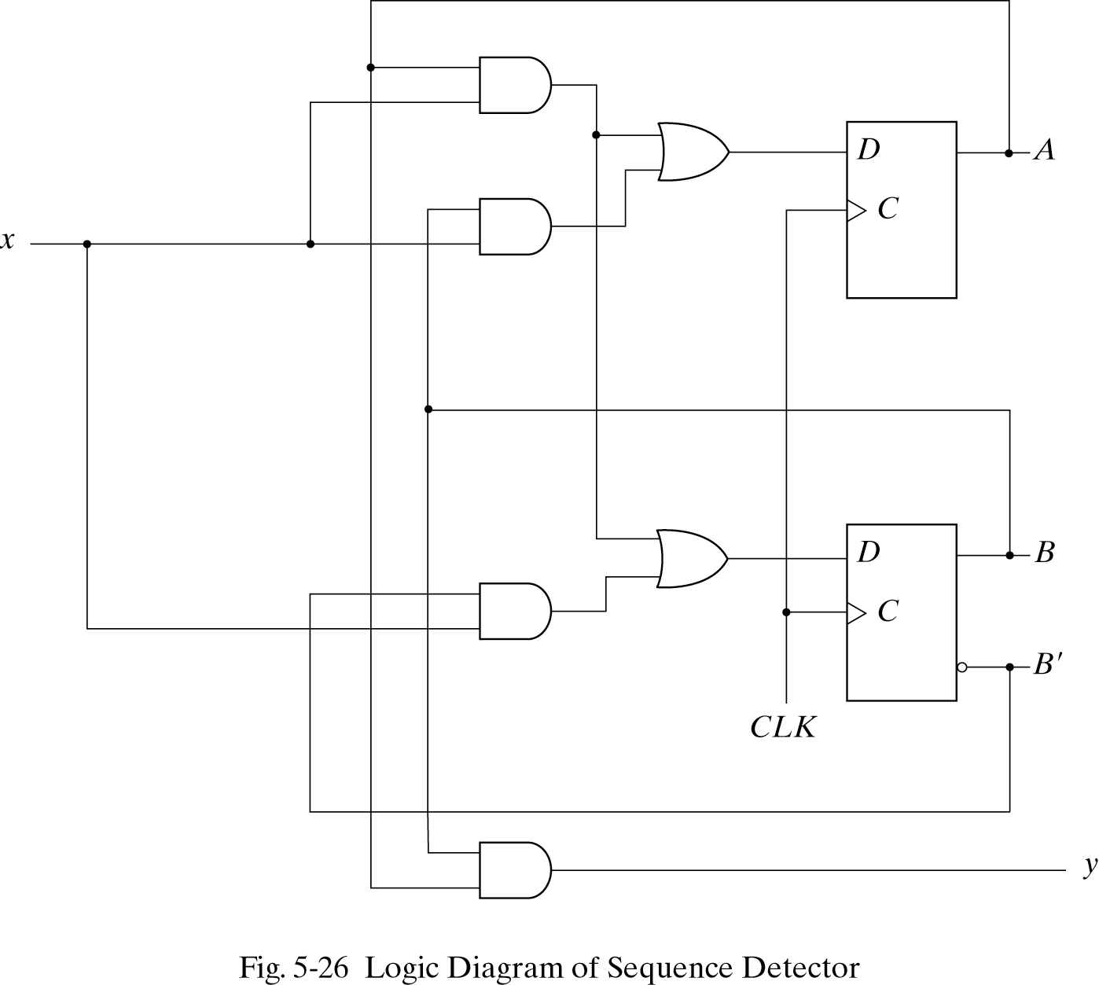
Circuit for Consecutive 1s Detector
Note location of state flip flops
Output value (y) is function of state
This is a Moore machine.

Slide 58
Concept of the State Machine
Example: Odd Parity Checker
Assert output whenever input bit stream has odd # of 1's
Symbolic State Transition Table
State
Diagram
Encoded State Transition Table
Note: Present state and output are the same value
Moore machine

Slide 59
Concept of the State Machine
Example: Odd Parity Checker
Next State/Output Functions
NS = PS xor PI; OUT = PS
D FF Implementation
Timing Behavior: Input 1 0 0 1 1 0 1 0 1 1 1 0

Slide 60
Mealy and Moore Machines
Solution 1: (Mealy)
Solution 2: (Moore)
0/0
0
Reset
Even
Even
Input
Output
[0]
1/1
O/P is dependent
on current state and
input in Mealy
1/0
1
1
Input
Output
Transition
Arc
Odd
Odd
[1]
Output is
dependent only
on current state
0
0/1
Mealy Machine: Output is associated with the state transition
- Appears before the state transition is completed (by the next clock pulse).
Moore Machine: Output is associated
with the state
Appears after the state transition
takes place.

Slide 61
Vending Machine FSM
Step 1. Specify the problem
Deliver package of gum after 15 cents deposited
Single coin slot for dimes, nickels
No change
Design the FSM using combinational logic and flip flops

Slide 62
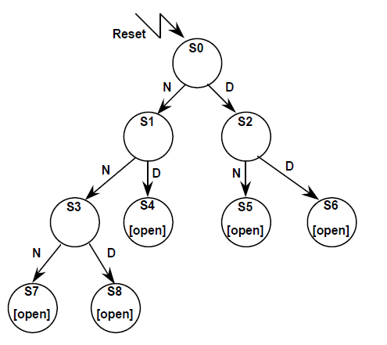
Vending Machine FSM
Step 2. Map into more suitable abstract representation
Tabulate typical input sequences:
three nickels
nickel, dime
dime, nickel
two dimes
two nickels, dime
Draw state diagram:
Inputs: N, D, reset
Output: open

Slide 63
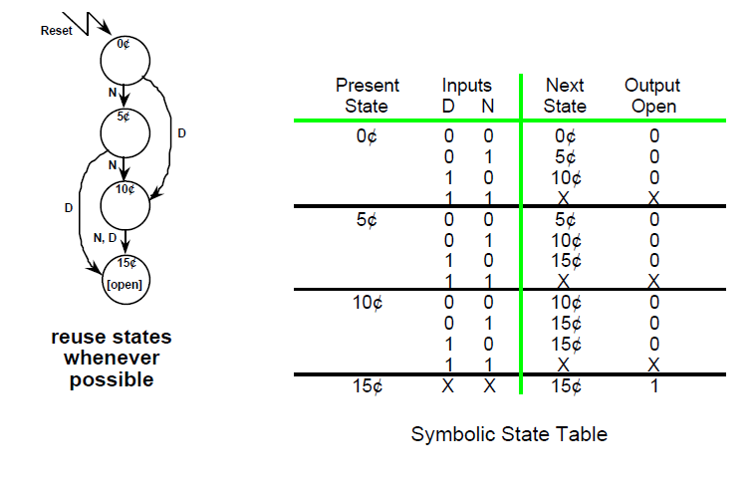
Vending Machine FSM
Step 3: State Minimization

Slide 64
Vending Machine FSM
Step 4. State Encoding
How many flip-flops are needed?

Slide 65
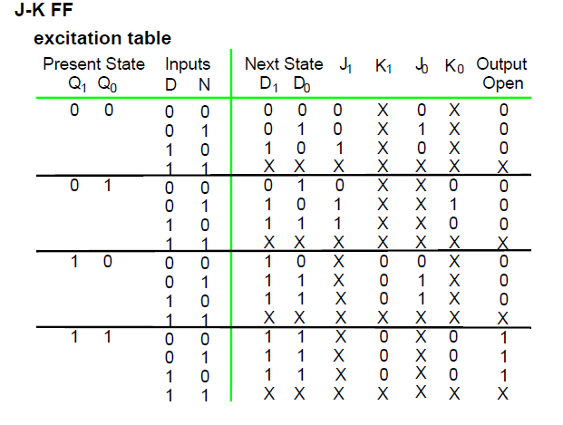
Vending Machine FSM
Step 5. Chose FF type for implementation

Slide 66
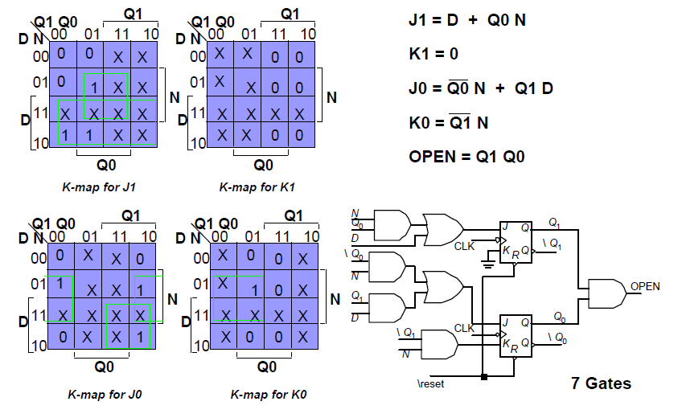
Vending Machine FSM
Step 6. Combinational circuit minimization(JK FF )

Slide 67
Vending Machine FSM
Step 6. Combinational circuit minimization(D FF easiest to use)
Q1 Q0
Q1
Q1 Q0
Q1
Q1 Q0
Q1
D N
D N
D N
N
N
N
D
D
D
Q0
Q0
Q0
K-map for D1
K-map for D0
K-map for Open

Slide 68
Minimized Implementation
Q₁
D
D₁
Q₁
D Q
Q₀
CLK
R
Q
N
Reset
OPEN
N
Q₀
D₀
Q₀
D Q
Q₁
CLK
Q
R
N
Reset
Q₁
D
Vending machine FSM implementation based on D flip-flops(Moore).

Slide 69
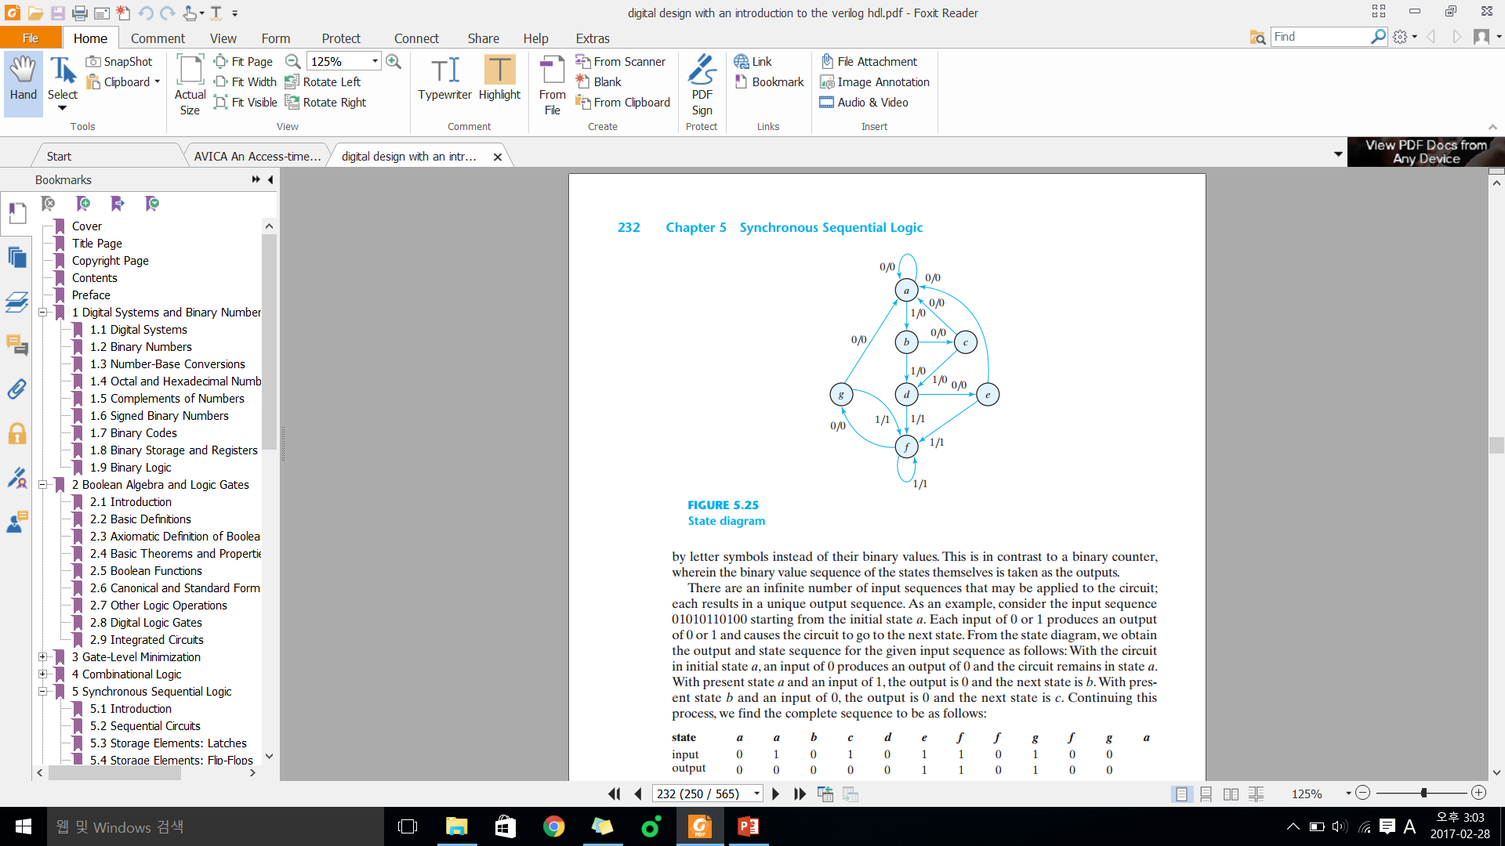
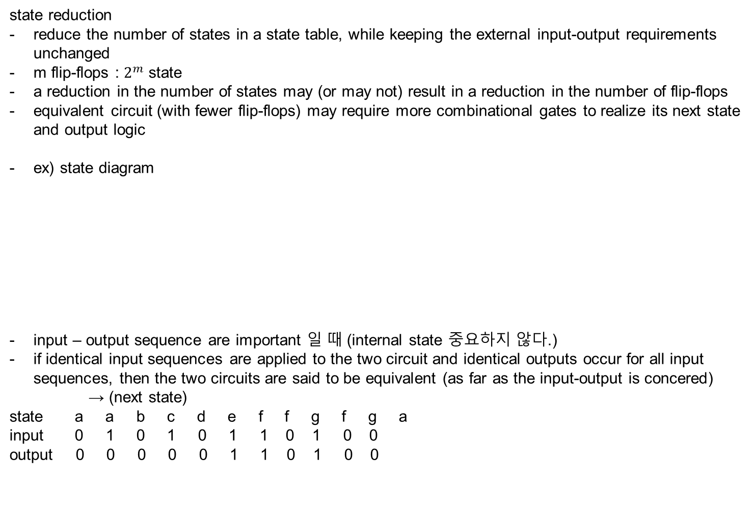
state reduction and assignment
state reduction
reduce the number of states in a state table, while keeping the external input-output requirements unchanged
m flip-flops : $2^{m}$ state
a reduction in the number of states may (or may not) result in a reduction in the number of flip-flops
equivalent circuit (with fewer flip-flops) may require more combinational gates to realize its next state and output logic
ex) state diagram
input – output sequence are important 일 때 (internal state 중요하지 않다.)
if identical input sequences are applied to the two circuit and identical outputs occur for all input sequences, then the two circuits are said to be equivalent (as far as the input-output is concered)
→ (next state)
state a a b c d e f f g f g a
input 0 1 0 1 0 1 1 0 1 0 0
output 0 0 0 0 0 1 1 0 1 0 0

Slide 70
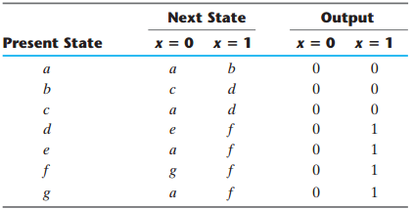
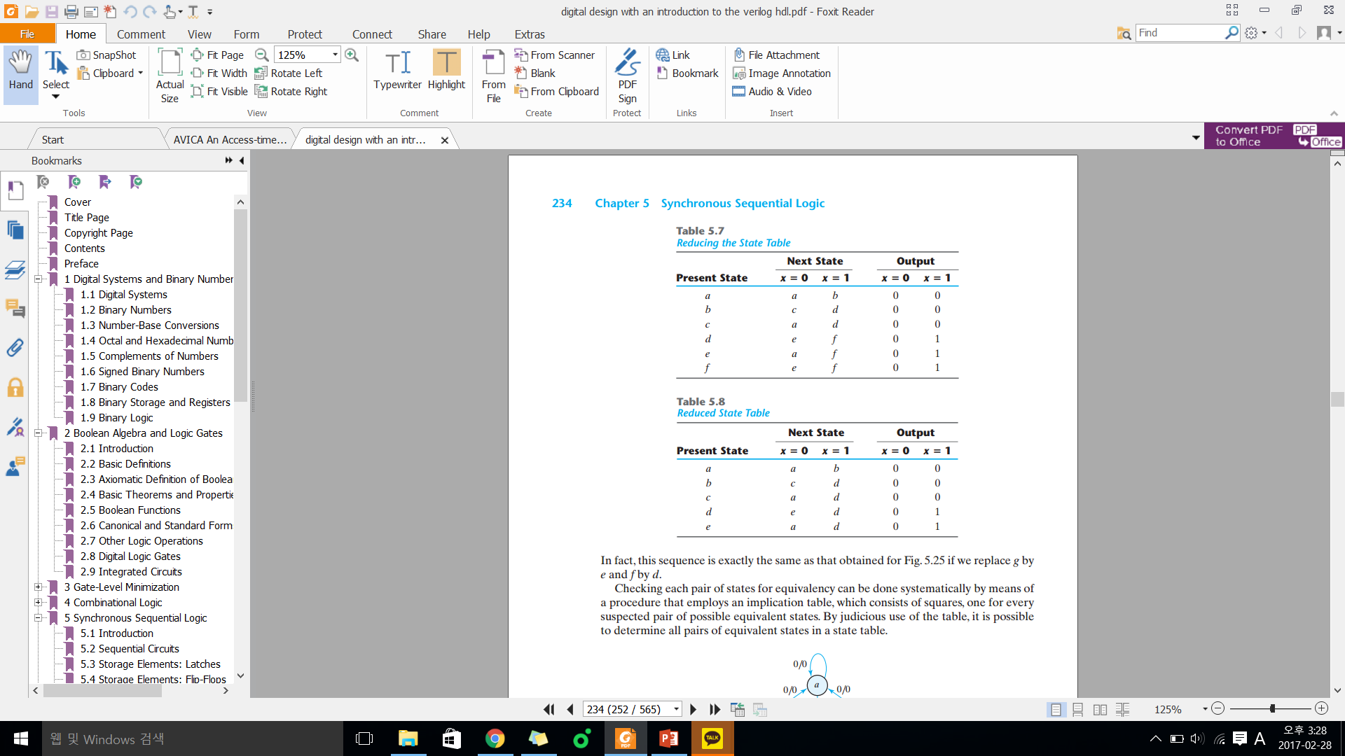
state reduction algorithm
two states are said to be equivalent it, for each number of the set of inputs, they give exactly the same output and send the circuit either to the same state or to an equivalent state. when two states are equivalent, one of them can be removed without altering the input-output relationships
<state table>
step 1.
step 2.
final

Slide 71
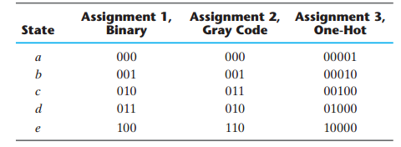
state assignment
unused states are treated as dont-care conditions
since dont-care conditions usually help in obtaining a simpler-circuits, it is more likely but not certain that the circuit with five states will require fewer combinational gates than the one with seven states
one-hot : 1. only one bit is equal to 1 while all others are kept at 0
2. one flip-flop per state
3. usually leads to simpler decoding (encoding) logic for the next state and output
the complexity of the combinational circuit depends on the binary state assignment chosen.

Slide 72
excitation table
synthesis : the part of the design that follows a well-defined procedure is referred to as synthesis
excitation table : lists the required inputs for a given change of state
1) JK flip-flop <characteristic stable>
Q(t) Q(t+1) J K J K Q(t+1)
0 0 0 X derive from 0 0 Q(t)
0 1 1 X ← 0 1 0
1 0 X 1 1 0 1
1 1 X 0 1 1 Q`(t)
1) T flip-flop <characteristic stable>
Q(t) Q(t+1) T T Q(t+1)
0 0 0 derive from 0 Q(t)
0 1 1 ← 1 Q`(t)
1 0 1
1 1 0
there are so many don’t care entries indicates that the combinational circuit for the input equations is likely to be simpler, because don’t care minterms usually help in obtaining simpler expressions. If there are unused states in the state table, there will be additional don’t care conditions

Slide 73
mealy and moore machine conversion
1) mealy → moore
ex) three 1 sequence detector
step 1) determine the number of different output associated with si in the next state => S2
step 2) split si into different states according to different output associated with it
=> s2 output 0 or 1 => s20 (output 0) s21 (output 1)
0/0
1/0
S0
S1
0/0
0/0
1/0
S2
1/1
present state | next state
 | x = 0 |  | x = 1
 | state | output | state | output
s0 | s0 | 0 | s1 | 0
s1 | s0 | 0 | s2 | 0
s2 | s0 | 0 | s2 | 1

Slide 74
mealy and moore machine conversion
<final>
moore는 동일한 mealy보다 outpu이 1 shift만큼 늦게 output이 나타난다.
present state | next state
 | x = 0 |  | x = 1
 | state | output | state | output
s0 | s0 | 0 | s1 | 0
s1 | s0 | 0 | s20 | 0
s20 | s0 | 0 | s21 | 0
s21 | s0 | 1 | s21 | 1
present state | next state |  | output
 | x = 0 | x = 1
s0 | s0 | s1 | 0
s1 | s0 | s20 | 0
s20 | s0 | s21 | 0
s21 | s0 | s21 | 1

Slide 75
mealy and moore machine conversion
1) moore → mealy
step 1) copy all the moore machine transition table into mealy machine transition table format
present state | next state |  | output
 | x = 0 | x = 1
s0 | s0 | s1 | 0
s1 | s0 | s2 | 0
s2 | s0 | s3 | 0
s3 | s0 | s3 | 1
present state | next state
 | x = 0 |  | x = 1
 | state | output | state | output
s0 | s0 | 0 | s1 | 0
s1 | s0 | 0 | s2 | 0
s2 | s0 | 0 | s3 | 1
s3 | s0 | 0 | s3 | 1

Slide 76
mealy and moore machine conversion
step 2) state reduction
<final>
present state | next state
 | x = 0 |  | x = 1
 | state | output | state | output
s0 | s0 | 0 | s1 | 0
s1 | s0 | 0 | s2 | 0
s2 | s0 | 0 | s3 | 1

Slide 77
Summary
Finite state machines form the basis of many digital systems
Designs often start from clear specifications
Develop state diagram and state table
Optimize using combinational design techniques
Mealy or Moore implementations possible
Can model approach using HDL.
Notes:
credential:
bring a computer
die photo
wafer
:
This can be an hidden slide. I just want to use this to do my own planning.
I have rearranged Culler’s lecture slides slightly and add more slides. This covers everything he covers in his first lecture (and more) but may
We will save the fun part, “ Levels of Organization,” at the end (so student can stay awake): I will show the internal stricture of the SS10/20.
Notes to Patterson: You may want to edit the slides in your section or add extra slides to taylor your needs.

